Slide 1
Howard County Economic Outlook and Personal Income Forecast
Presentation to the Howard County Spending Affordability Committee
Agenda
National Outlook
Maryland Outlook
Howard County Economy
Personal Income Forecast
January 28, 2021

Slide 2
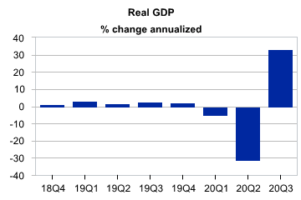
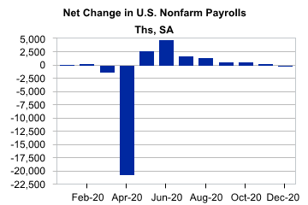
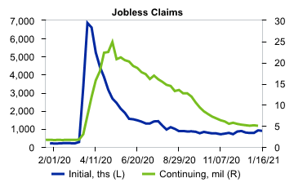
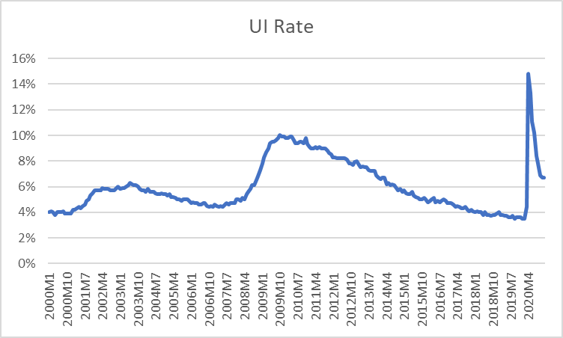
National Outlook
Oh How Things Have Changed
From Longest Recovery to Deepest Decline
Moody’s “The pandemic has created unprecedented volatility in U.S. GDP. The record-shattering 31.4% annual decline in real GDP was followed by a similarly record-breaking 33.4% gain, according to the BEA’s third estimate. The gain reversed about 75% of the prior decline.”

Slide 3
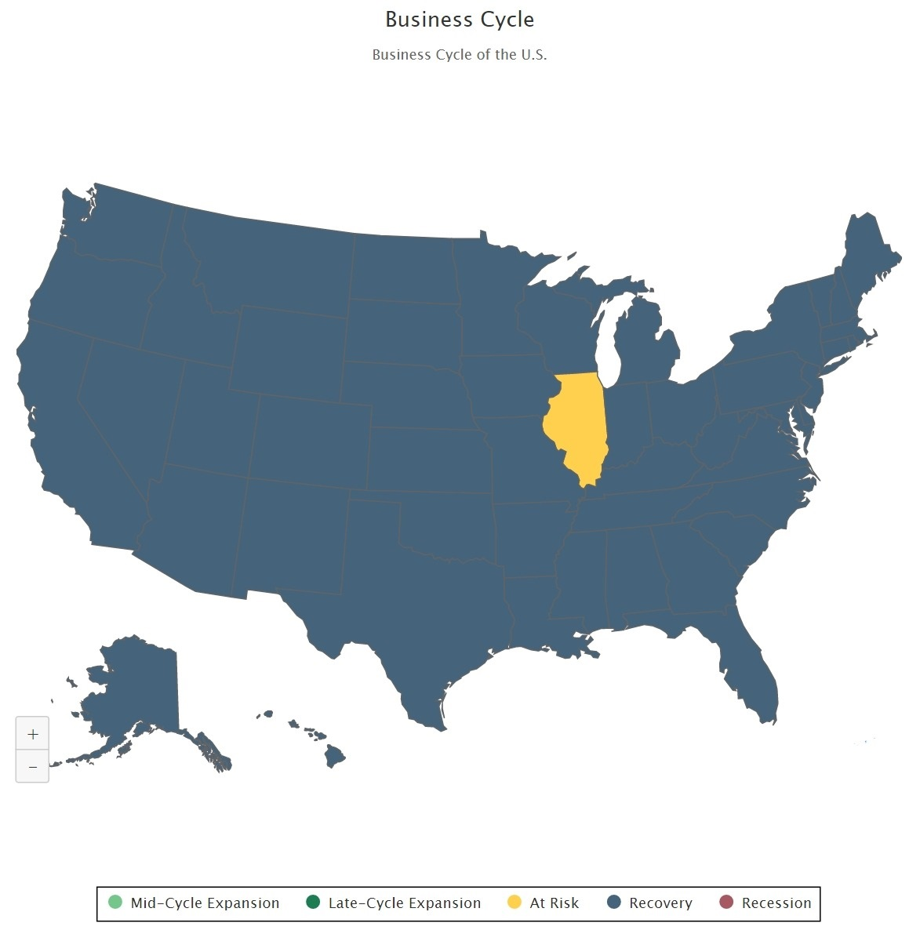
National Outlook – We Are in Recovery
Last Year – All States Recovering or Expanding
This Year – 49 States and DC are Recovering
  Maryland – Risk of Recession in Next 6 Months = 27% / 37th Nationally – Better than DC (31%) Comparable to VA (26%)
Moody’s GDP Projections
  -3.5% in 2020 -- +5% 2021 and 2022
Based on – Continued Vaccine Rollout and Fiscal Stimulus

Slide 4
National Outlook
Impact on State and Local Budgets
  While we are recovering – Things will take a while to get back to pre-pandemic levels (Late 2023)
  Impact on State and Local Budgets will extend into FY2021 and FY2022
  State budgets nationally a shortfall of $224 Bil.- More if we go into Recession
  Without additional federal assistance we project states and local governments will be forced to raise taxes or cut spending by between $171 billion and $301 billion over the next year and a half.

Slide 5
Maryland Outlook
Moody’s and BORE in Agreement on MD Economy and Recovery
Board of Revenue Estimates
Maryland’s economy has structural factors in its favor. In typical recessions, the state’s economy and employment contracts less than the national average. Maryland has a higher income labor force than the nation. This is partly due to the presence of the federal government, which has been a growing source of well-paying jobs over the pandemic.
Our outlook therefore calls for growth in employment and aggregate wages to slow but continue over the winter months.
Growth through 2021 is expected to accelerate as pent-up demand is unleashed and then settle into pre-pandemic trends in 2022.
Moody’s
Maryland is slowly crawling out of its COVID-19-driven recession. The state is still outperforming the region, given a smaller initial decline in nonfarm payrolls at the outset of the pandemic.
Maryland’s recovery will slow in the fourth quarter and unemployment will remain stubbornly high even though MD is better equipped to handle the fallout from the pandemic than most states. It will take until 2023 for employment to reach its pre-virus level.

Slide 6
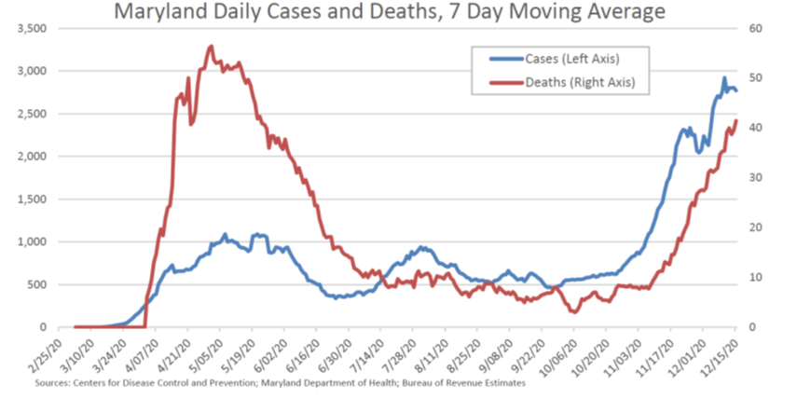
Maryland Outlook
Expected Recovery Depends on:
  Reductions in COVID Cases
    This will Determine Reopening
  Pace of Vaccination
  Fiscal Stimulus
While the Economy is Expected to Recover by the End of Year – Fiscal Impacts will Take 2 or So Years to Clear.
  Foreclosures impact on Real Estate?

Slide 7
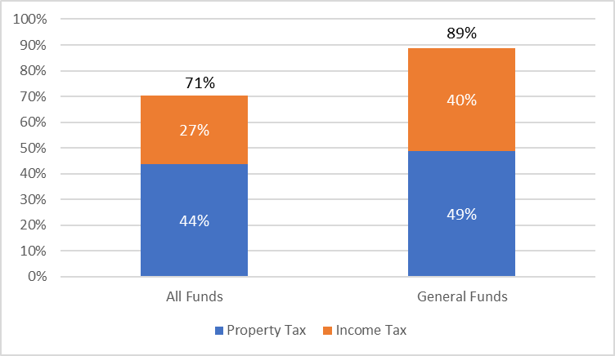
Howard County Outlook
Income and Property Tax Drive Revenues
What Drives the County’s Economy and Fiscal Conditions?
Population Growth
  Who are we Attracting?
  Workforce Growth
Economic Growth
  Job Growth
  Types of Jobs
Real Estate
  Residential
  Non-Residential

Slide 8
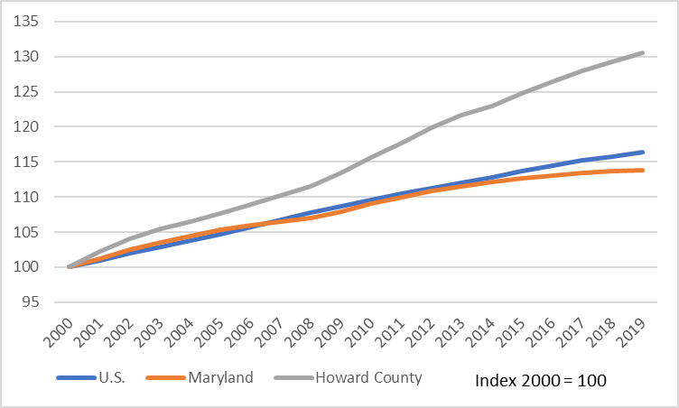
Howard County Outlook
- Population
Howard is the Fastest Growing County in Maryland
Howard County
6th Largest County
Fastest Growing %
3rd in # of People
County Outpaces the U.S. and Maryland in Population Growth

Slide 9
Howard County Outlook
- Population
Outmigrants Had Higher Income s than In-Migrants for 6 of the Last 8 Years
Gaining Population From Natural Growth and International/Domestic In-Migration
Howard County
2nd in Domestic Migration
One of 12MD Counties with Positive Domestic Migration
4th in International Migration
Gaining From Maryland +4,307 Returns – Losing to Other States -2,006 Returns
In Maryland:
Gaining from Montgomery, Prince George’s Baltimore
Losing residents to Carroll, Frederick, Anne Arundel

Slide 10
Howard County Outlook
-- Population and Workforce Growth is a Key Driver of Income Tax
Howard County is a Growing Employment Center
  34% of Residents Work In-County
  42% in Other Baltimore Metro
  37% Work in DC Suburbs
Howard County Emerging as an Employment Center
  Net In-Commute of 22,000 Workers
  # Of County Residents Employed In-County Increased by 20% (44% of Residents – up from 40% in 2010)
County Has Substantial Workforce and Demographic Assets
County Population is:
  High Income - $121,392 Median Household Income - 9th in Nation
    Up from 11th last Year – Down from 2nd in 2016 (
  Engaged in Work Activities – 70% Labor Force Participation
    Above MD (68%) / Below DC Metro (72%)
  Educated – 64% Bachelor’s or Above
    Above MD (41%) and DC Metro (51%)
  Professional – 65% in Professional Occupations and 47% Employed in the Professional Services/Education/Health Sector

Slide 11
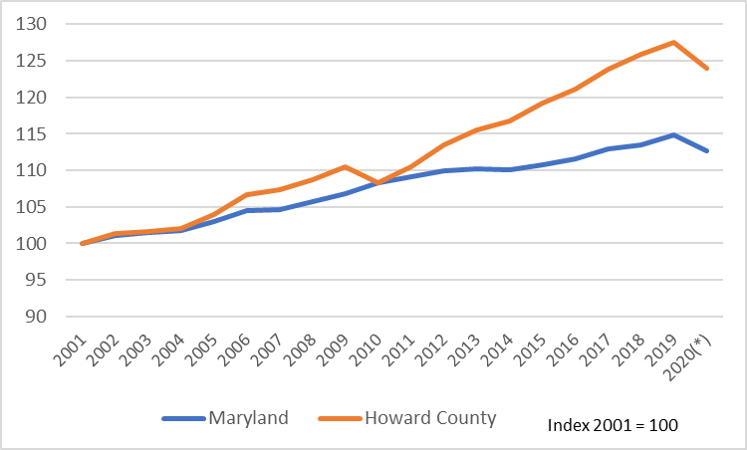
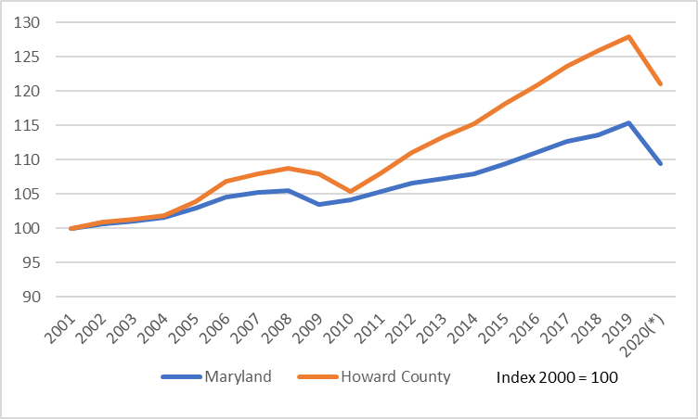
Howard County Outlook
-- Population and Workforce Growth is a Key Driver of Income Tax
Labor Force – Long Term Growth but Short Term Problems
Employed Residents – Generally Stronger than MD but Lagged since 2019
Howard County Labor Force Fell by 2.8% - Only a 1.9% Decline in Maryland
Howard County Employed Residents Declined by 5.3% - Comparable to the 5.2% Decline in Maryland

Slide 12
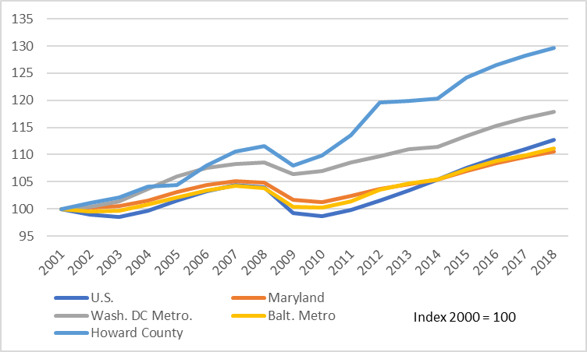
Economic Growth
-- A State and Regional Leader
Howard County is the Fastest Growing County in MD since 2009 and Added the 2nd Most Jobs
Leading State and Both the Baltimore and Washington Metro Areas in Growth
Howard County Tracked the U.S. with 1.4% Job Growth in 2019
Maryland, Baltimore Metro and DC Metro Lagged Nation

Slide 13
Economic Growth
-- Diversified and Strong Employment Base
Strong Long (34% since 2001) and Post Recession (25% since 2009) Employment Growth
Diverse Growing and Specialized in:
  Middle Skill Sectors (Construction and Wholesale)
  High Skill Sectors (Professional Services)
Emerging Corporate and Headquarters Location (Management of Companies)
Opportunities in Healthcare and Hospitality Sectors

Slide 14
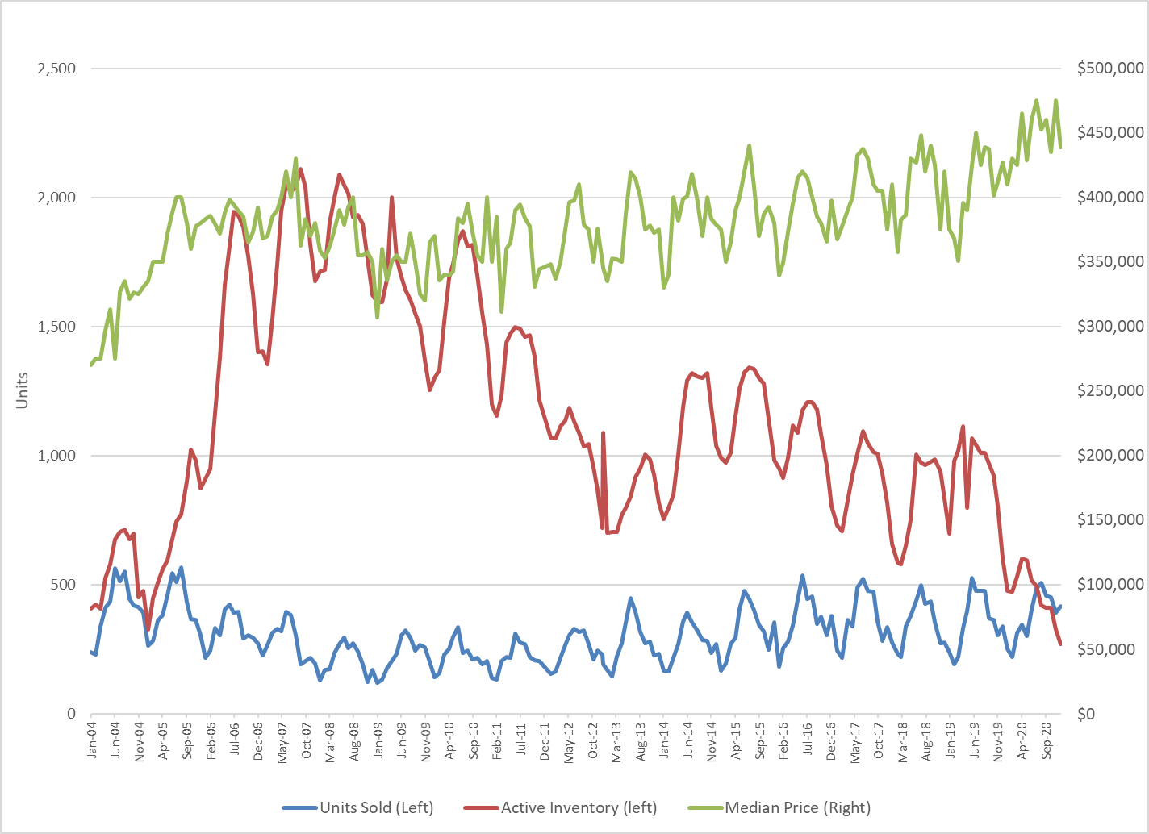
Howard County Outlook
Real Estate Growth – Drives Property Tax (Largest Source of County Revenues)
Real Estate Market Hot
Median Sales Price - $410,000 to $475,000 in 2020
  Highest in Maryland
Inventory Matches Units Sold
  Less than 1 Month Inventory

Slide 15
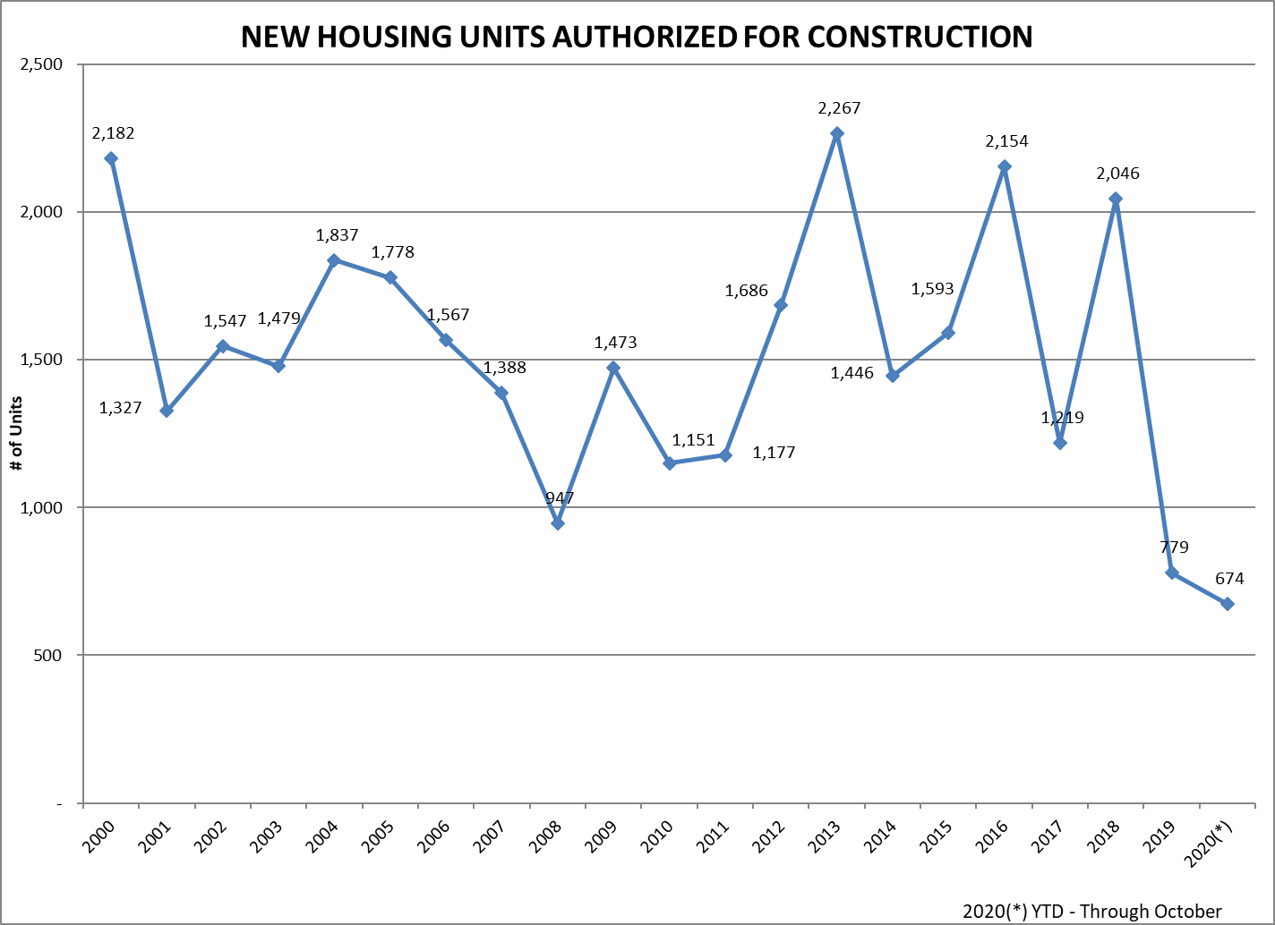
Howard County Outlook
-- Residential Development
Limited Residential Development Activity
  APFO
  Impact Fees
  Land Inventory
This is Despite a Hot National, State, Regional and Local Housing Market

Slide 16
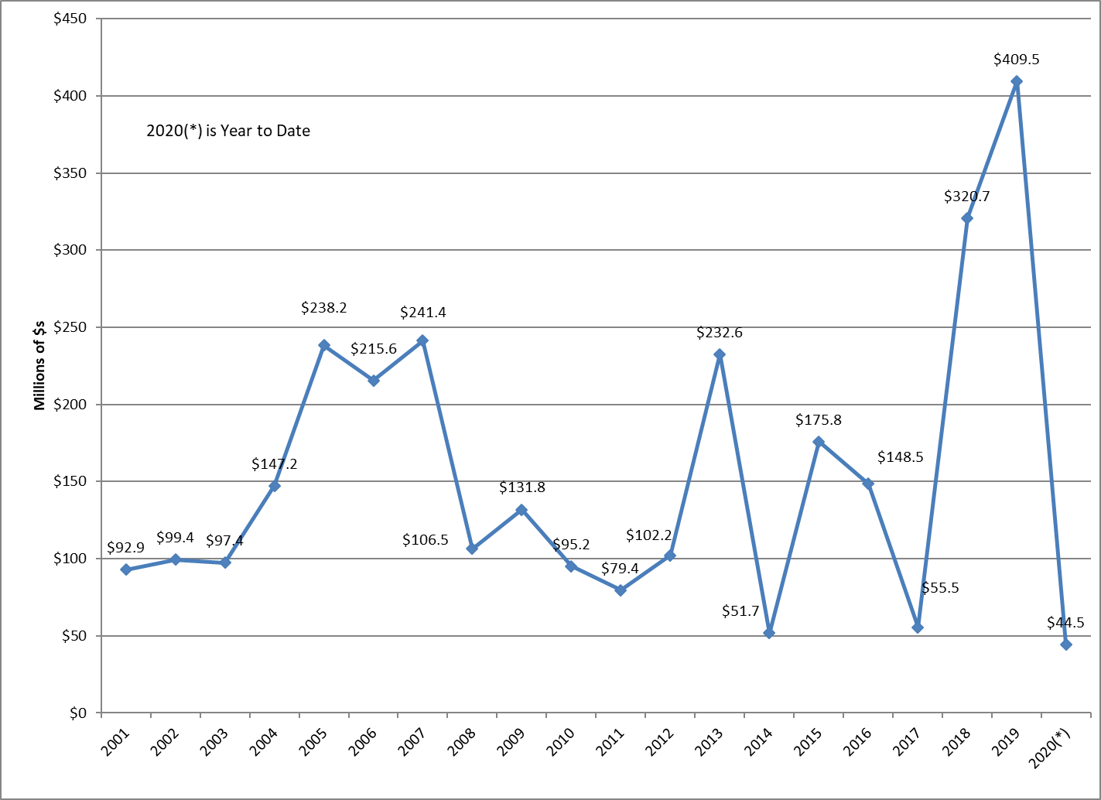
Howard County Outlook
-- Non-Residential Development
Numerous Headwinds
Precipitous Drop in Non-Residential Permits
Essential To Support Employment and Non-Residential Tax Base Growth
County Running Out of Land
  HCEDA and Planning Presentation
Impact of COVID-19
  Less Office Space per Worker
  Changes in Retail Demand
  More Suburban Office Space (Where Workers Are)?
APFO – Live Where you Work is a Key Marketing Strength – Less Residential Development Could Translate in to Less Commercial Demand

Slide 17
Howard County Outlook
Economic Outlook
Hard to Make Predictions
COVID
  New Variants vs. Vaccines
  Pace of Vaccine Delivery
Additional Federal Stimulus
  Aid to State and Local Governments
New Administration – Should Benefit Maryland with its Reliance on Federal Spending and Employment
Fiscal - State Fiscal Conditions are not as bad as they could have been, but
  Effects of Last Year will Last into the Future
  Kirwan Commission

Slide 18
Personal Income Projections - Baseline
Scenario #1 - Baseline
Based on Historical Model
Calendar Year Projections
  5.1% in 2020 (Federal COVID Response)
  1.2% in 2021 (Assumes Limited Additional COVID Response)
  Return to Normal in 2022
The County is Facing Significant Fiscal Constraints Next Two Years

Slide 19
Personal Income Projections - Baseline
Scenario #2 – Lower Growth
Lower State Growth Projections and Slower Population Growth
Calendar Year Projections
  4.9% in 2020 (Federal COVID Response)
  0.6% in 2021 (Assumes Limited Additional COVID Response)
  Personal Income Growth Lags Maryland Growth
The County is Facing Significant Fiscal Constraints Next Two Years and Slower Growth After That

