Slide 1
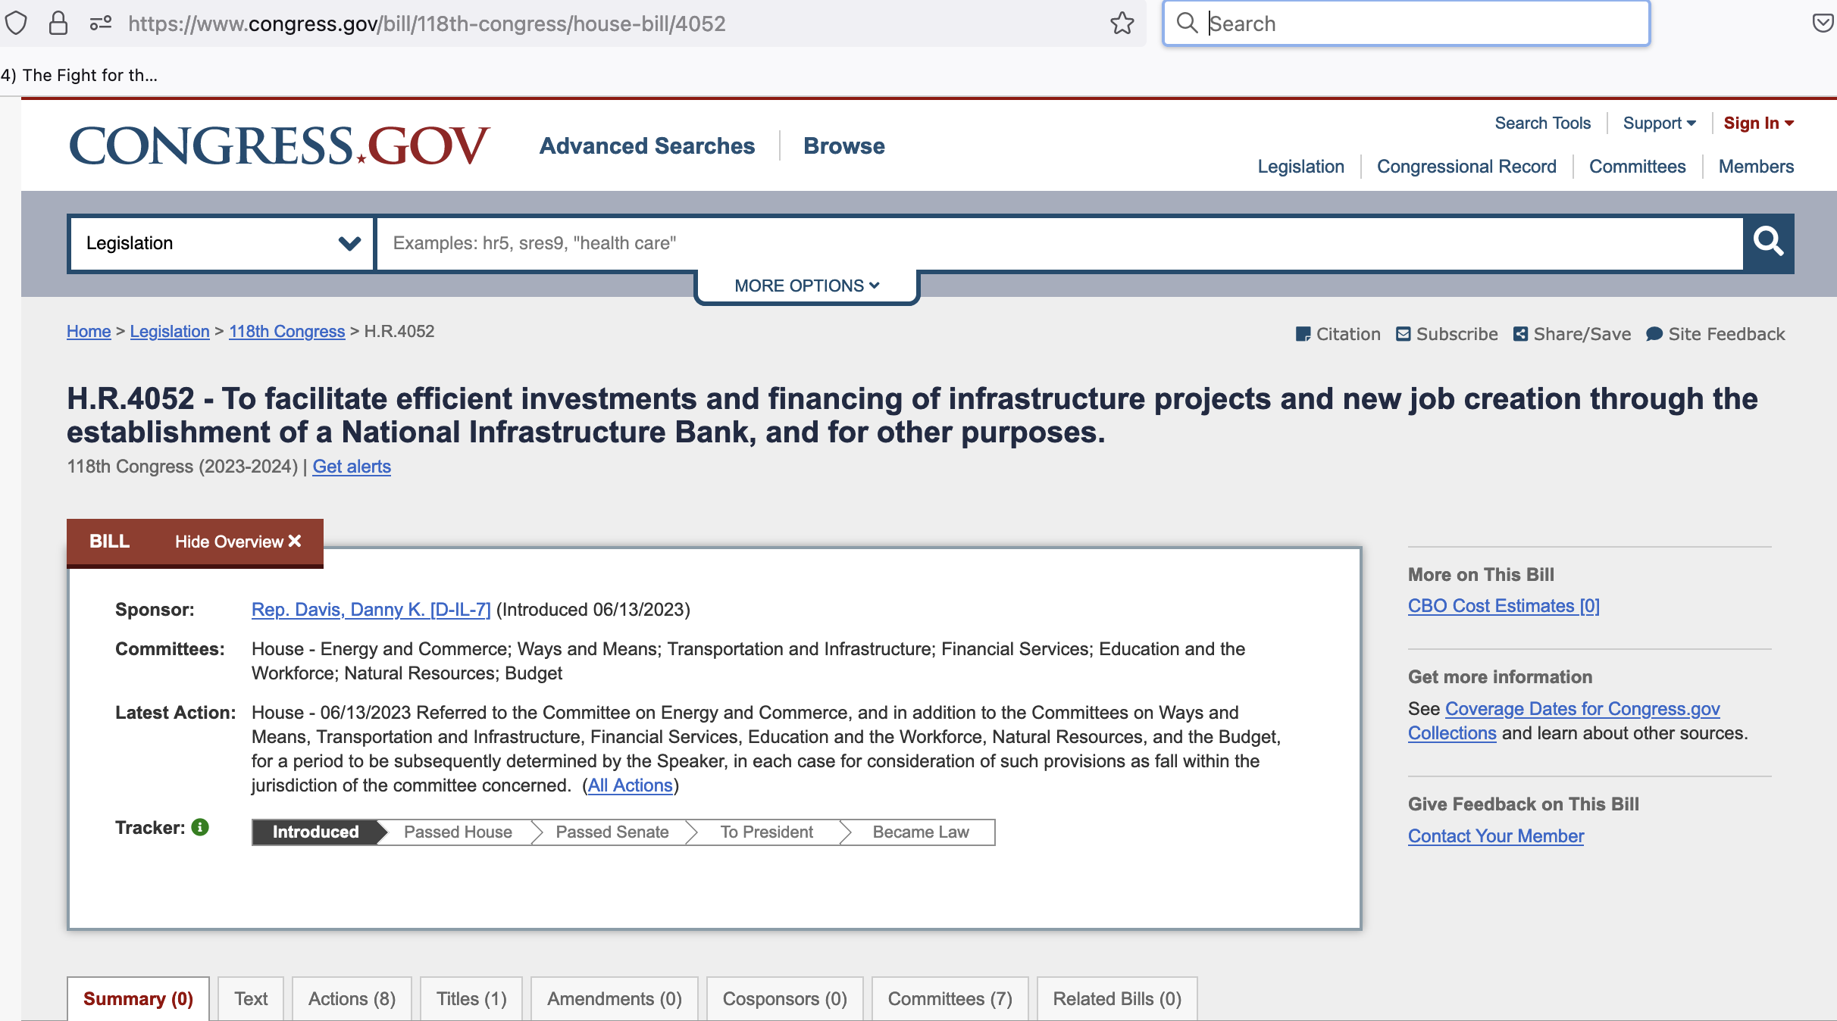


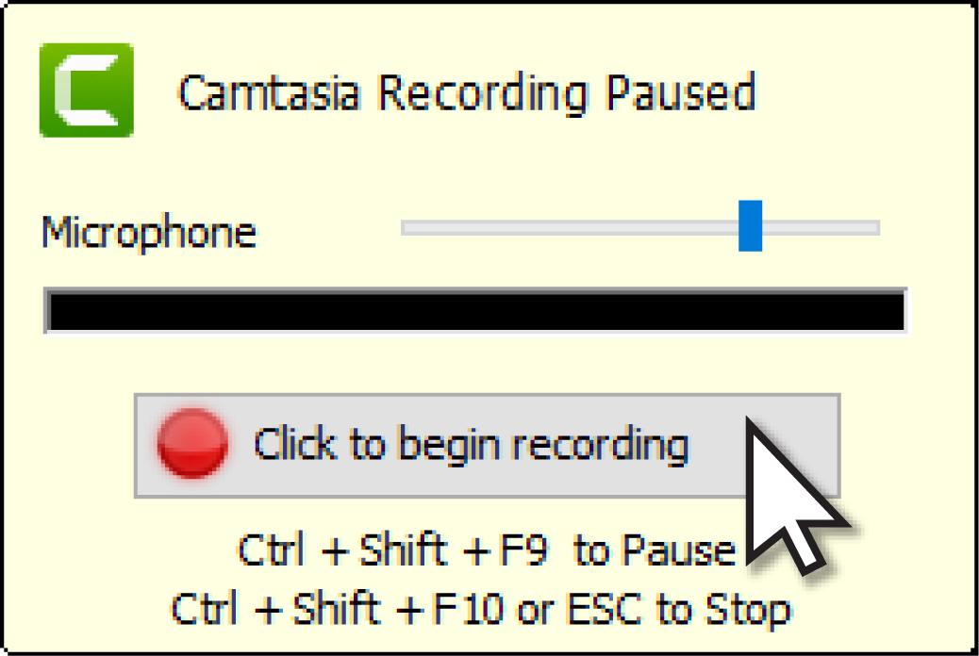

Slide 2
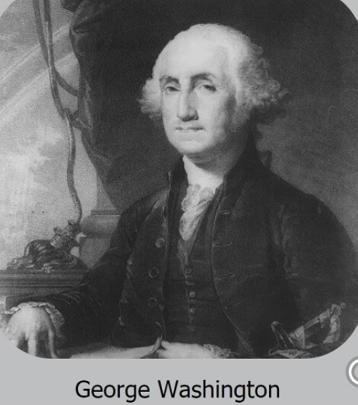
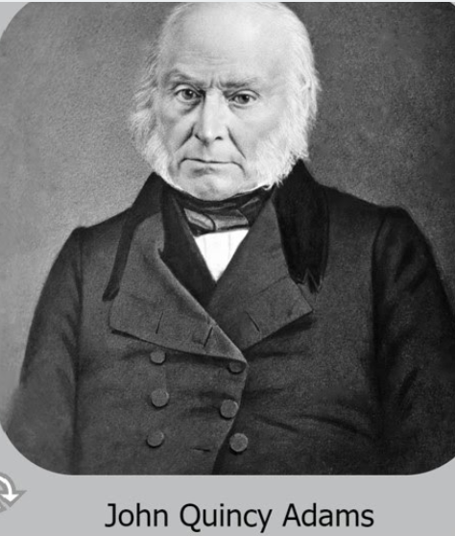
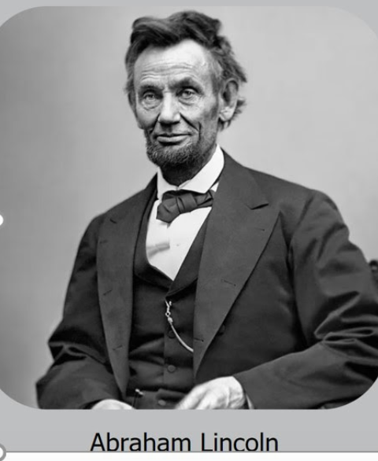
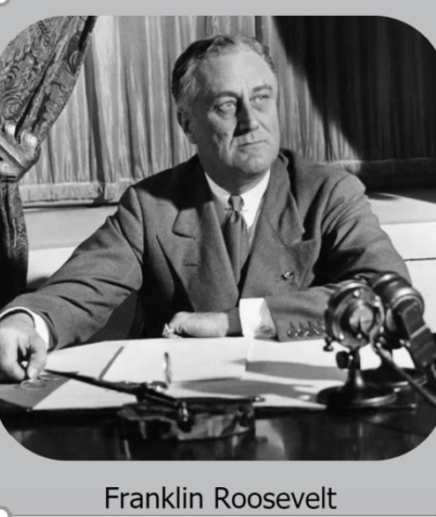
Six American Presidents used a Hamiltonian Public Bank
First Bank of US
(1791 - 1811)
Second Bank of US
(1816 - 1836)
National Banking System
(Banking Act of 1863)
Reconstruction Finance Corp (1932 - 1957)
1945
See Alexander Hamilton’s financial plan.
Started by Pres. James Madison
Started by Pres. Herbert Hoover

Slide 3
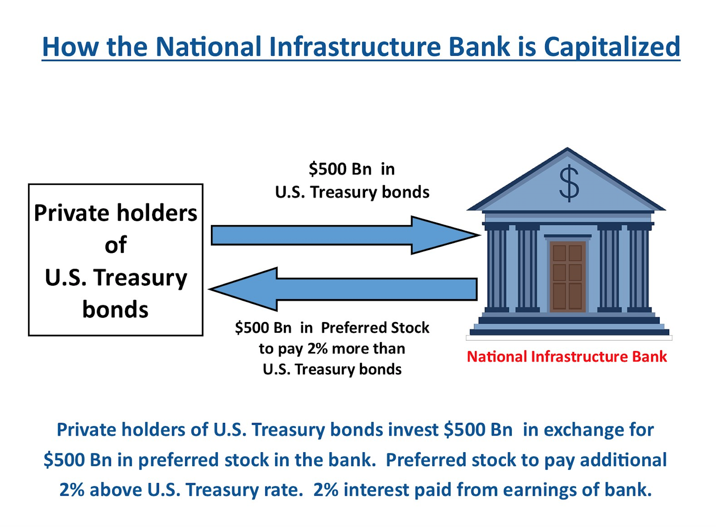
NO Federal Money Needed !

Slide 4
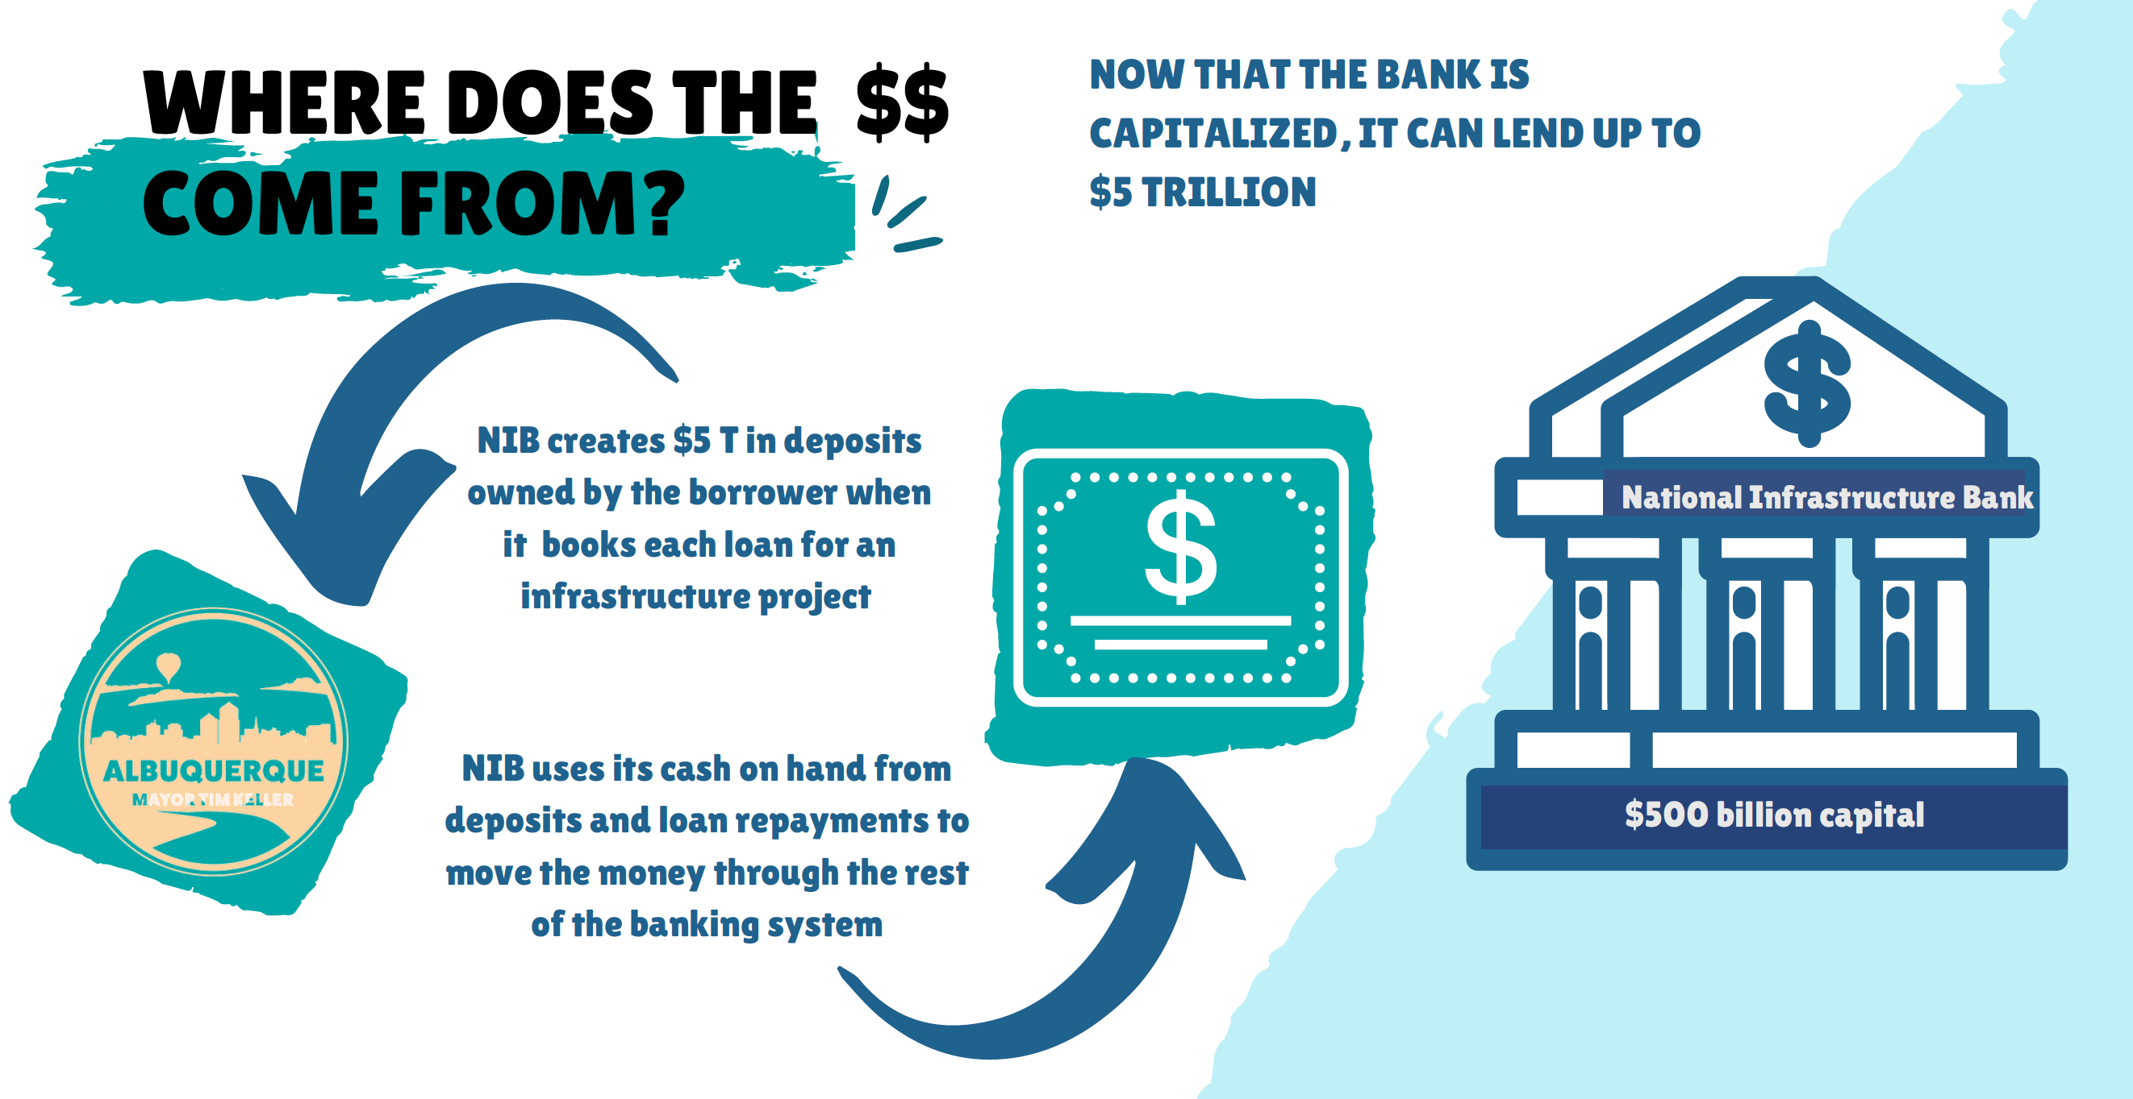
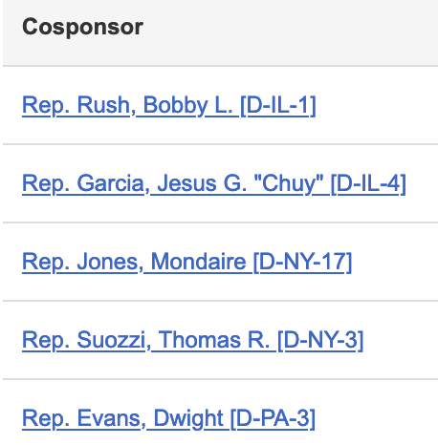

Slide 5
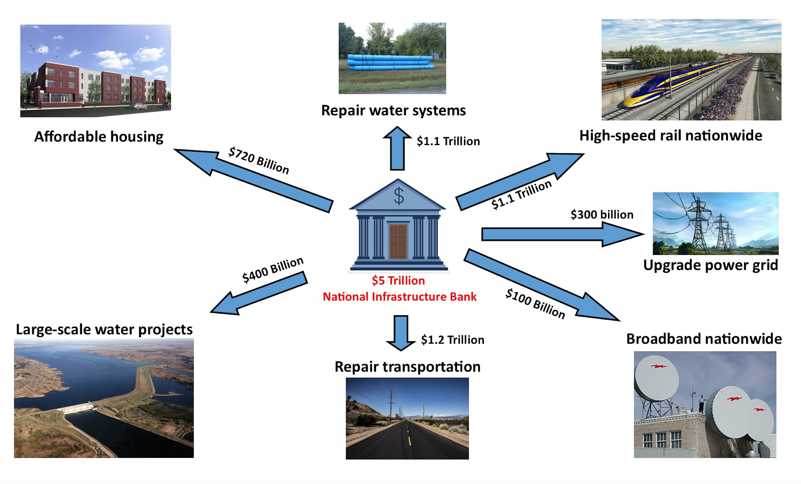
What the NIB Covers

Slide 6
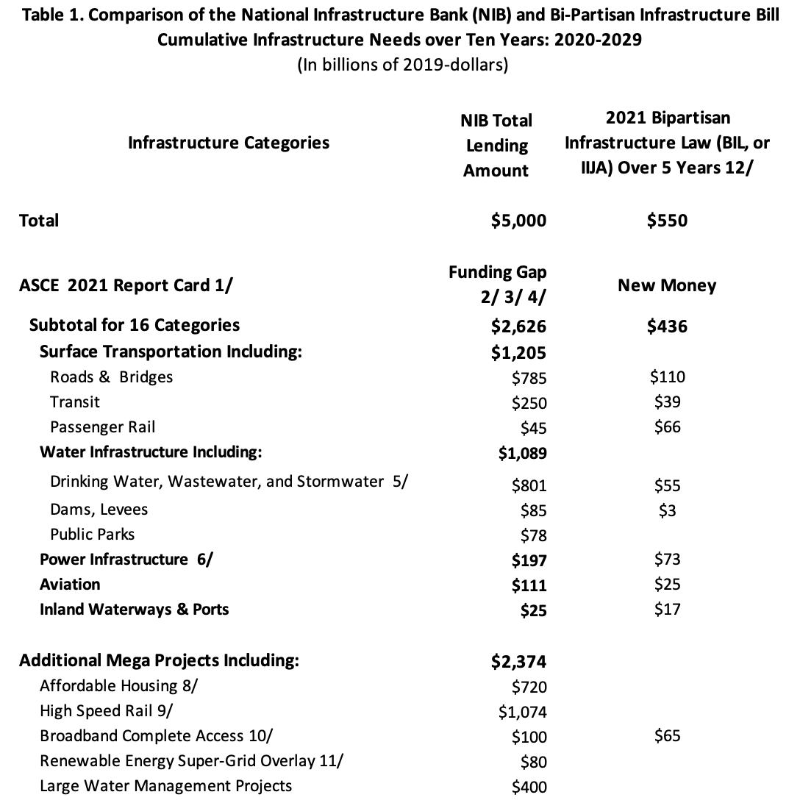
NIB Fully Finances Infrastructure Needs

Slide 7
$5T Supercharges the American Economy !
Creates 25 million new jobs, paying Davis Bacon Wages, with full benefits.
Buy America only for construction inputs; Makes America Manufacture Again.
Estimated to raise GDP growth to 5%/year, and Productivity to 3.5%/year.
No new Federal Taxes or Debt!
Reduces Inflation!
Offsets coming Recession!
Every Sector Thrives:
Rebuilds American industry.
Small and Medium Businesses grow, including with new High Speed Rail, and spinoff business opportunities.
Workers benefit; poverty and income inequality are reduced.
Rural and urban improvements. Everyone receives adequate funding.
Federal, state and local finances improve: higher revenues from growth, and fewer workers needing social safety nets.

Slide 8
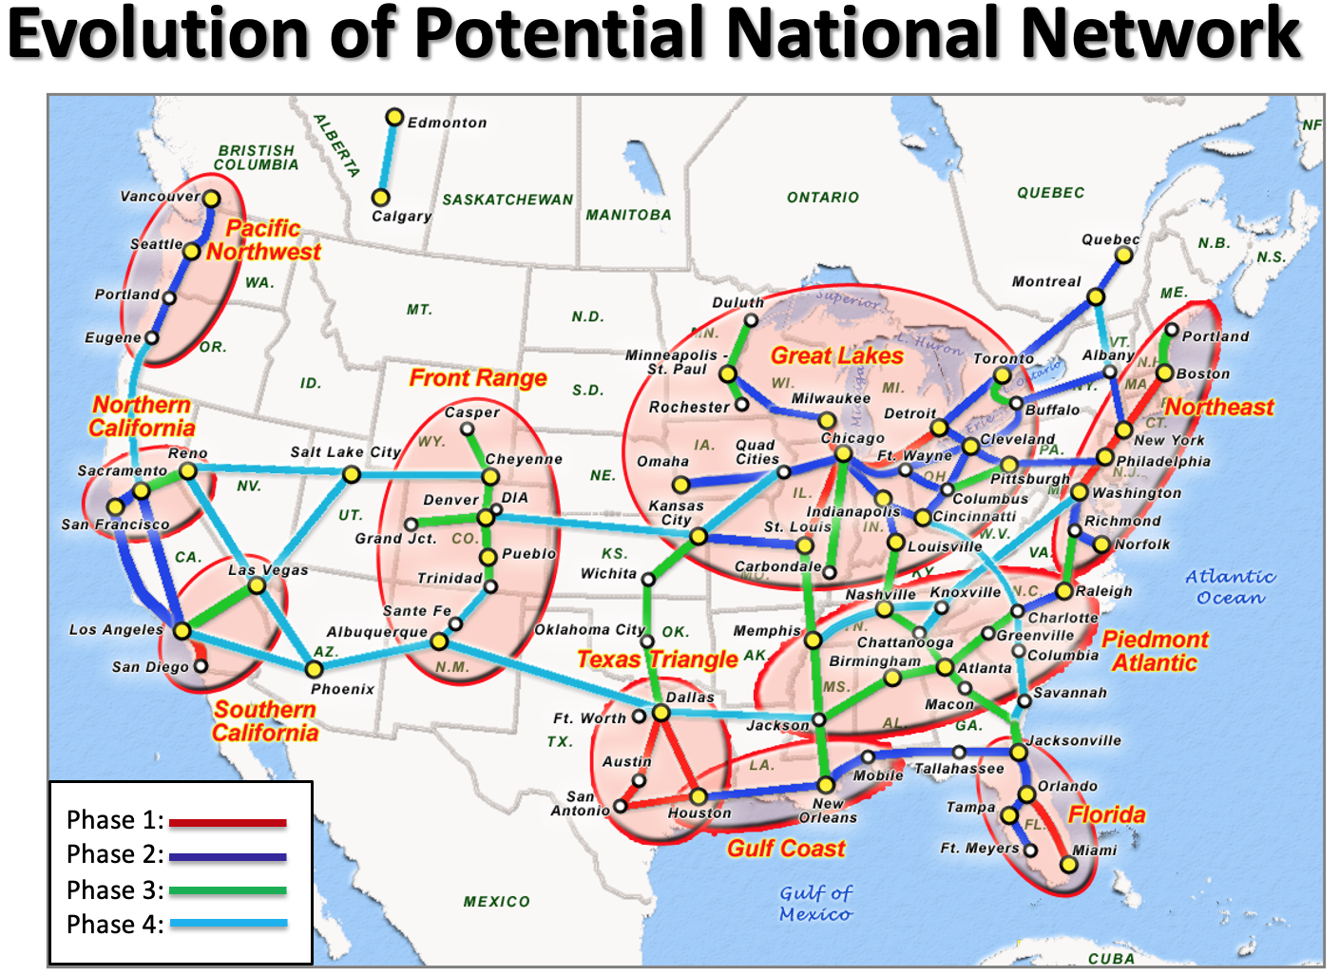
NIB Adds High Speed & Passenger Rail to the Transportation Mix
$1.1 trillion in NIB financing earmarked for High Speed Rail (Operating Speeds of 186-220 miles per hour):
Grows the economy along economic corridors, just like Transcontinental RR did and China did.
Relieves congestion on roads and at airports.
Requires no local monies to subsidize operations.
Passenger and Express Freight Rail
Finances all the new passenger lines identified by Passenger Rail Association.
Moves passengers and freight faster, more efficiently.
Better connects rural and urban areas.
Energy and Economy Savings
Moving passengers and express freight by rail, rather than road or air, saves 2/3 on fuel and CO2 emissions.
Economical too. Ex: HSR between Eugene Oregon and Vancouver Canada would cost $42 billion while generating $355 billion in economic benefits. By comparison, widening the I-5 highway between those cities by one lane each way would cost $108 billion and do nothing to relieve congestion (WA DOT).
Less traffic congestion saves on wasted time and fuel; makes economy more productive; grows businesses.
Keeps America Competitive
Transportation Economics & Management Systems, Inc.

Slide 9
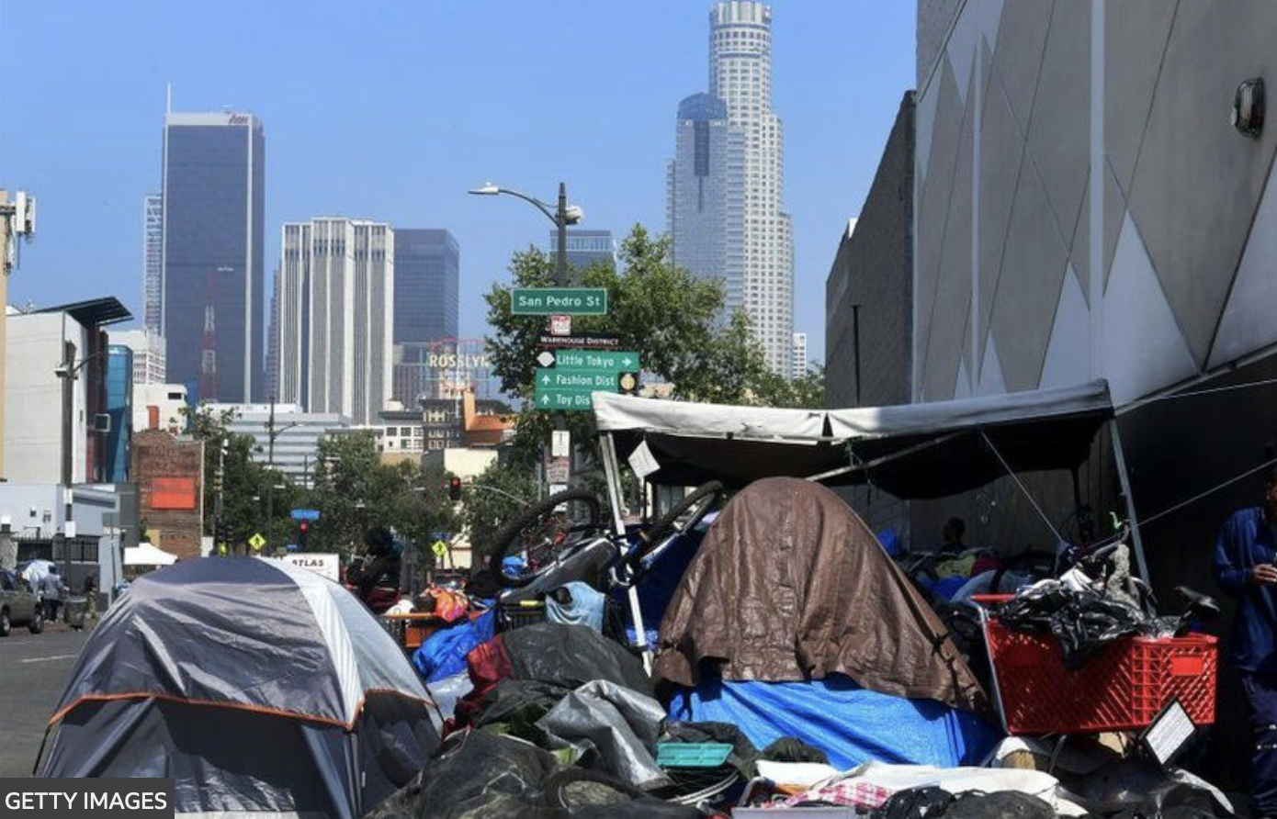
NIB solves homelessness, builds adequate affordable housing
Current State of U.S. Housing
Two million Americans are homeless (living in shelters or outdoors) including numbers of Veterans and children. Half the nation’s homeless live in CA. Other high rates in: NY, OR, WA, AK, HI, MA, CO, NV, NM, AZ, and FL.
Another 10-15% of all American households are housing insecure. Nearly half of renter households are “cost burdened,” paying more than 30 percent of their income in rent. Most are minorities. Overcrowding has already led to deaths: The Bronx Apartment Fire.
Two long-term factors drive homelessness: 1) low pay (minimum wage still $7.25/hour; 40 million Americans live below poverty line and are just a paycheck away from being evicted. 2) high cost of housing, spurred by Wall Street housing speculation, local land use policies, and the failure of market-based private real estate development to build affordable units.
The COVID pandemic caused workers to lose jobs, and raised evictions. Now Rents are skyrocketing.
NIB provides $720 billion over 10 years to build / re-build 7.3 million affordable housing units needed.
Creates 25 million new, family sustaining jobs to make housing more affordable for lowest income earners.
Employs best practices for social housing, to ensure it remains public and sustainable, and ia blended with mixed-use development.
Connects housing to improved commuter rail systems.
More than 69,100 people are homeless in Los Angeles (2022). 21% of CA households are housing insecure, says National Low Income Housing Coalition (NLIHC).

Slide 10
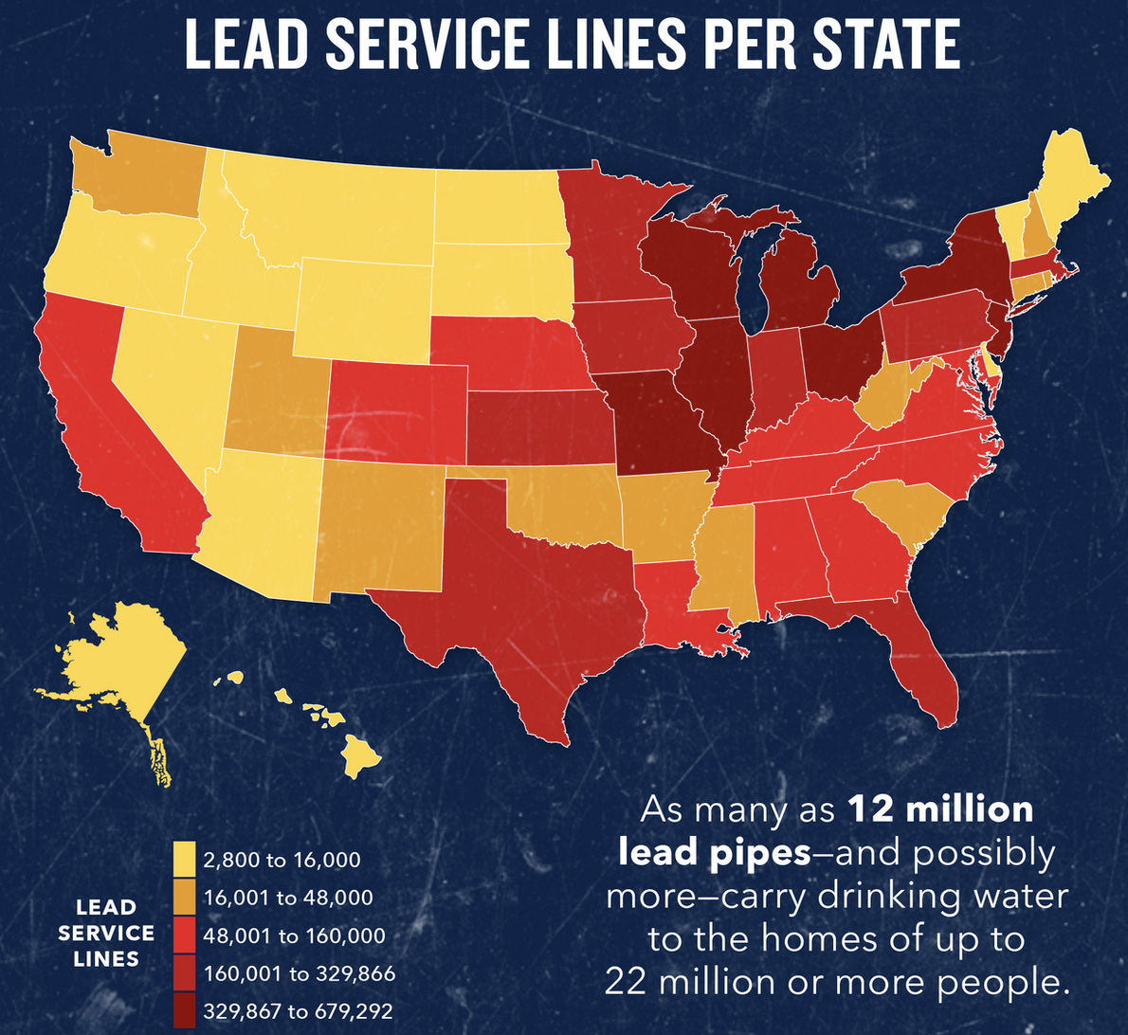
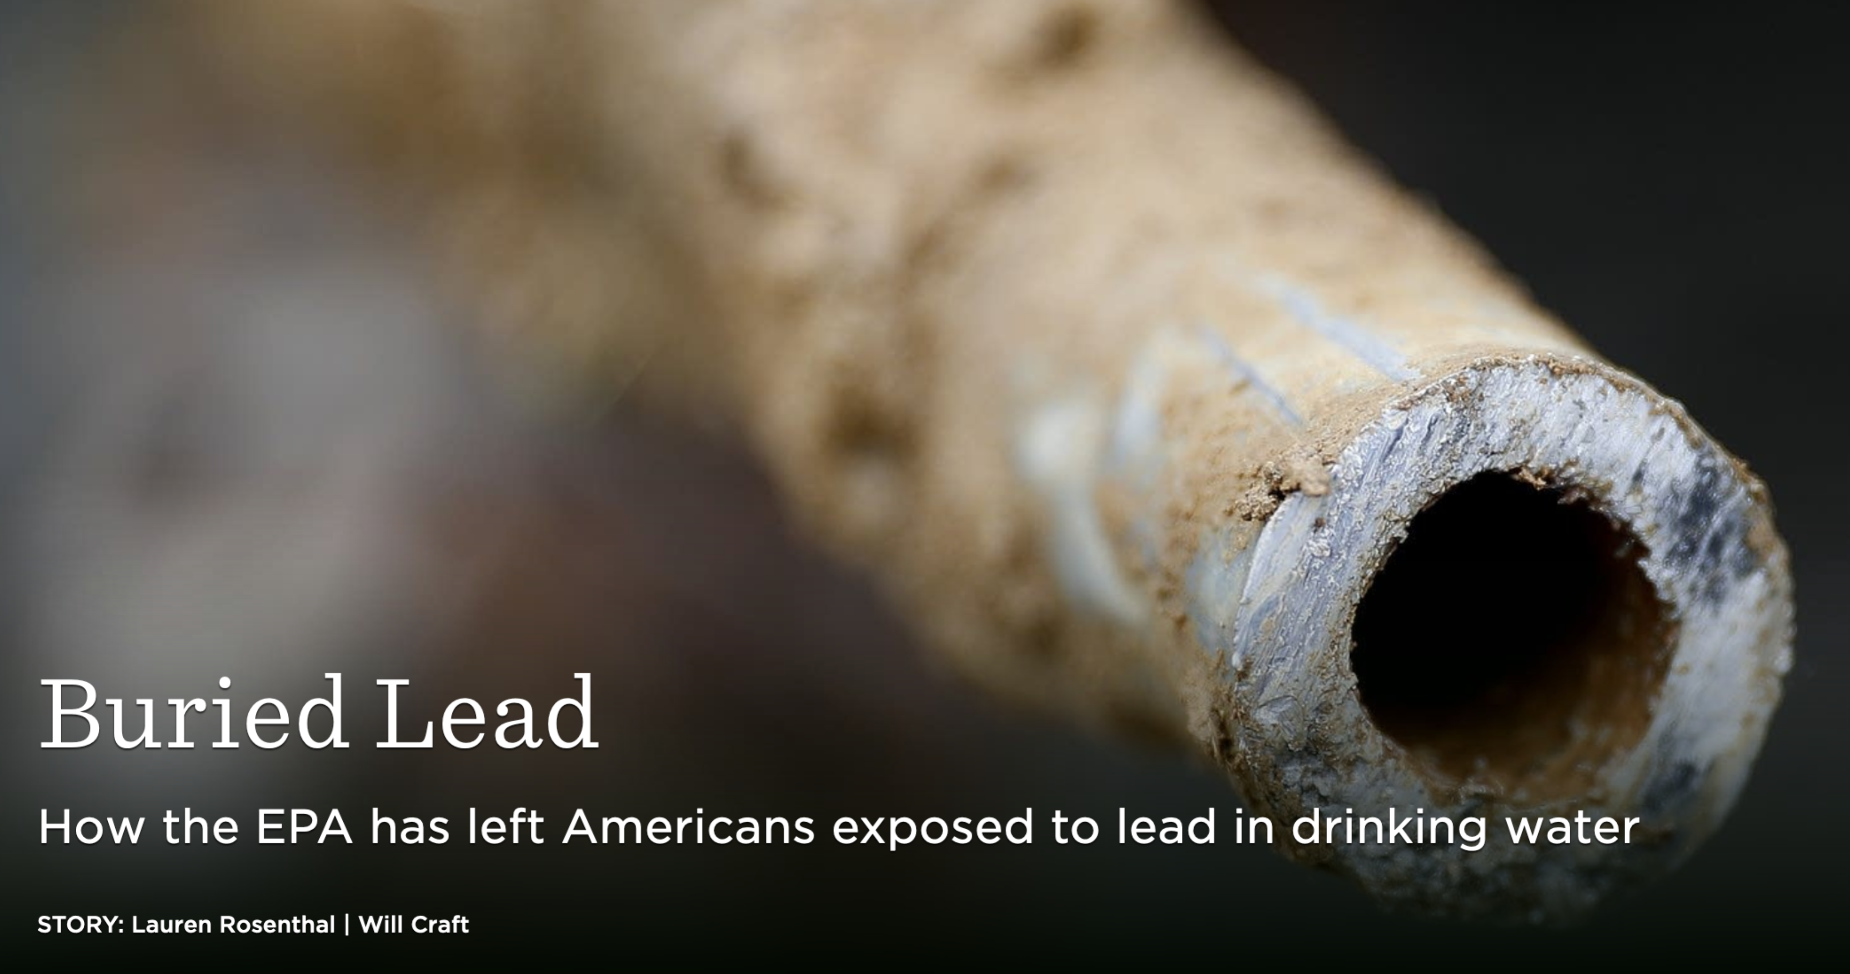
Safety First – Let’s Get ALL the Lead Out!
Research by Prof. M Allaire, U California, Irvine
Number of lead service lines = 7 to 11 million — more than 50,000 miles of lead pipes – serving 15 to 22 million people, or 7 percent of people living mostly in neighborhoods of color.
Prevalent in Northeast, Midwest, & older cities (see Map):
Northern New Jersey (Newark)
Buffalo, Rochester, and New York City
Worcester, Massachusetts
Providence, Rhode Island
Baltimore, Maryland. Portland, Oregon
Chicago, Il, $8 billion to replace 380,000 lines
Flint and Benton Harbor, Michigan
Milwaukee, Wisconsin, Indianapolis Indiana
Missouri, Kansas, Nebraska, Iowa highest levels per capita
Denver, Colorado - Example of Best Practices
Montgomery and Harris counties, Texas
Jackson, Mississippi
Prevalent in rural areas with populations < 3000: Severe in 3 Michigan, Texas, and Utah communities
National Infrastructure Bank replaces ALL lead pipes = $100 billion nationwide. Bipartisan Bill provides only $15 billion.
Currently: homeowners must pay to replace pipes in their yard: up to $15-20,000 per home – NIB will finance that.
In 2011, a team of EPA researchers in Chicago, led by Miguel del Toral, made a startling discovery: Millions of Americans were likely consuming more lead in their water than anyone had known before.

Slide 11
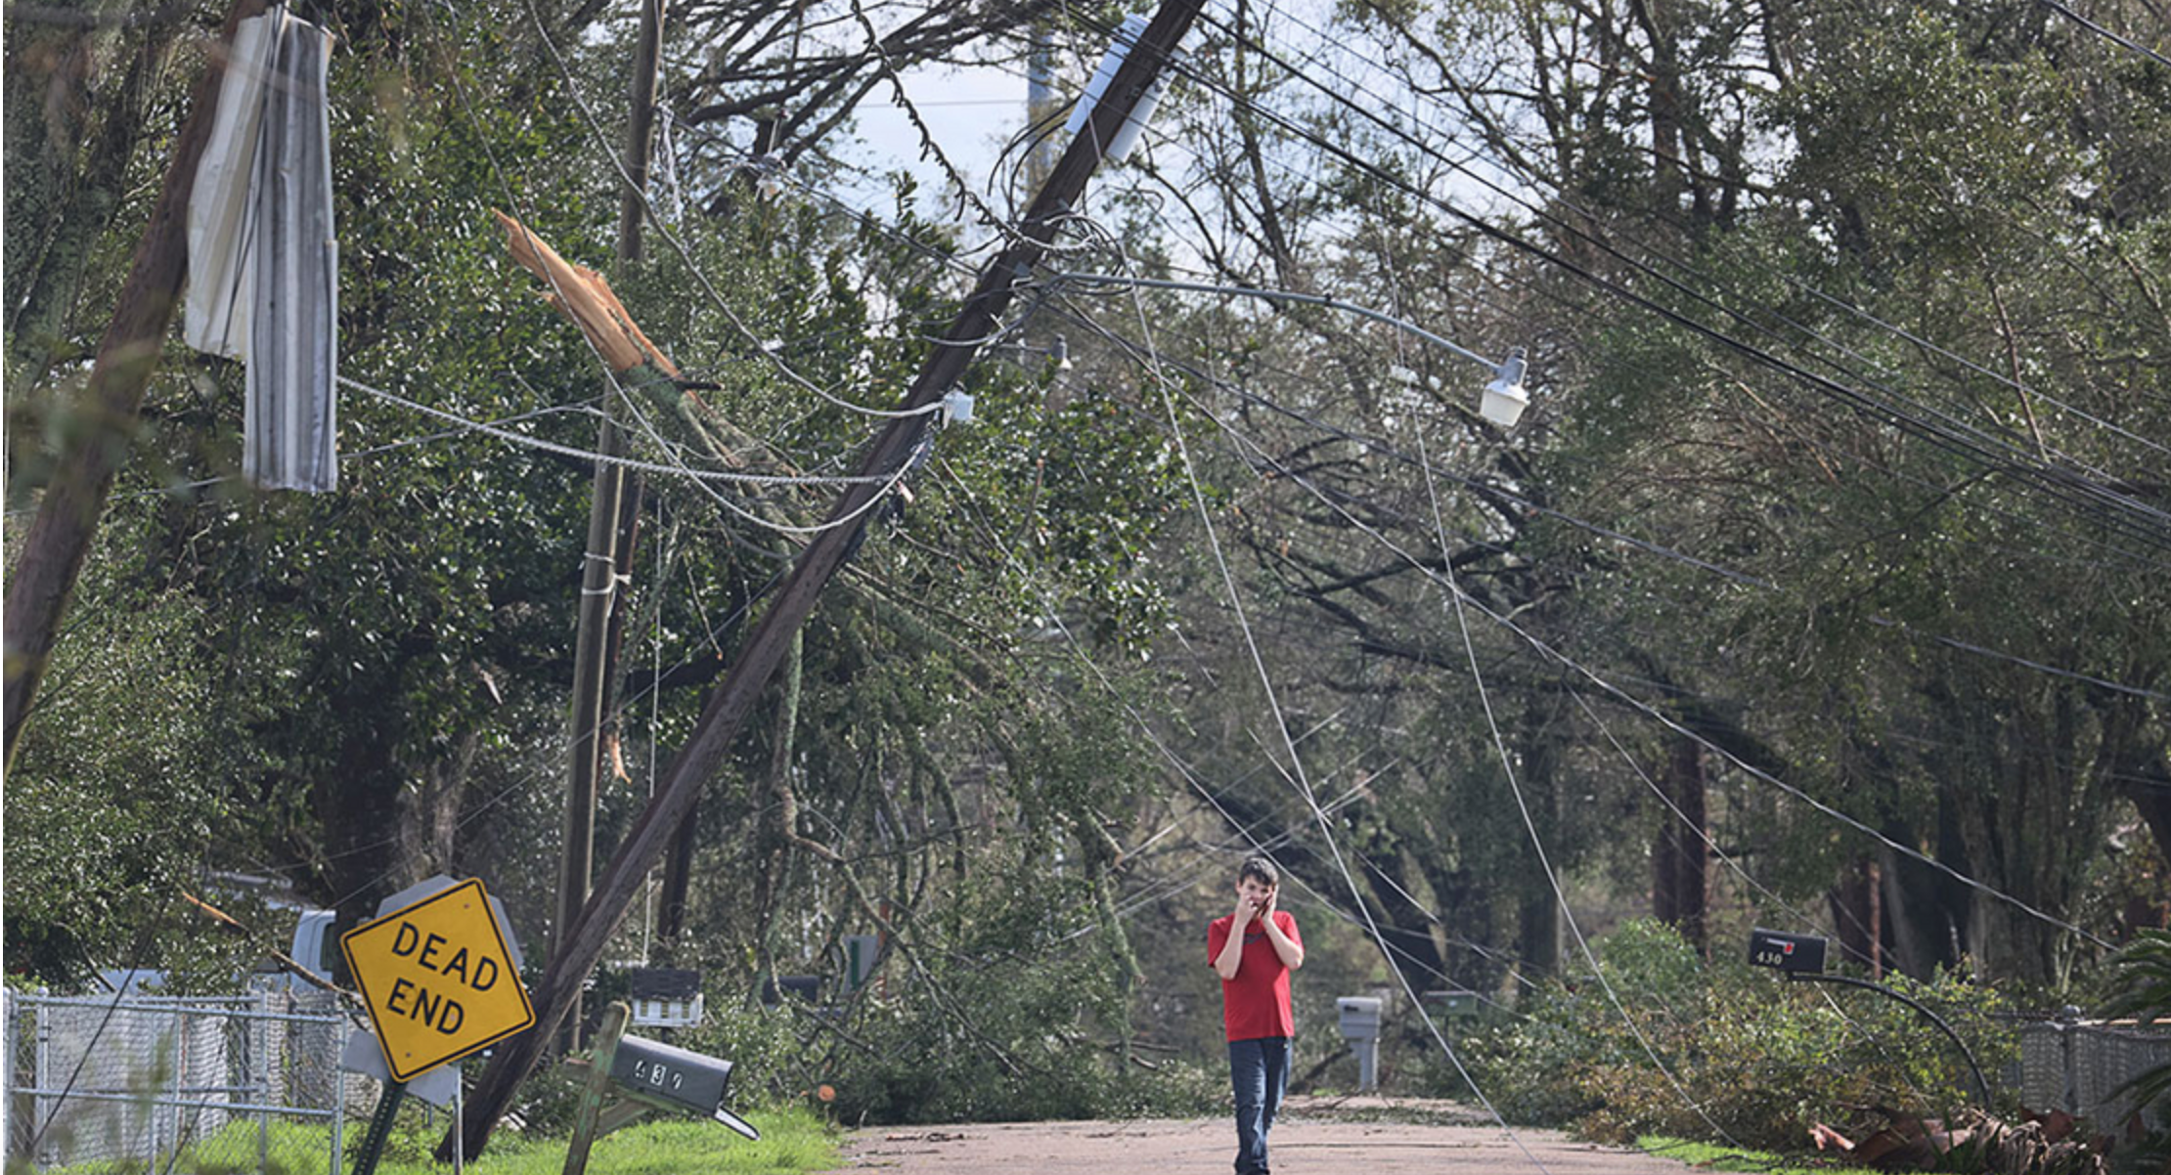
What are the Power Grid’s Vulnerabilities?
The Grid is Vulnerable to extreme weather events, cyber and physical attacks, and problems of peak demand
Power outages related to severe weather doubled over past five years (ME, LA, CA, FL). Past storm repairs have not provided resilience. PG&E needs $20B to bury CA transmission lines.
China-purchased transformers are not cyber secure.
Renewable Energy and EV Electric Vehicles will Strain the Grid
Plug-in cars are the future. The grid isn’t ready. Wind power not always reliable. Congestion prevents renewable power entering the grid. Smart grid technologies needed to conserve.
The Grid’s at maximum capacity in summer months; needs repairs; doesn’t have capacity to re-charge EVs.
$3 T needed from government to achieve zero carbon transportation by 2050, a DOE study found. More needed to electrify rail.
Government not yet taken Total Needs Into Account
ASCE estimates $200 B in new money is needed just for repairs. Infrastructure Bill provides only $73.
The National Infrastructure Bank would finance $200 B for new lines, resilience, cybersecurity, plus $80 B for a High Voltage Direct Current Transmission Grid Overlay
Hurricane Ida destroyed 22,000 power poles in New Orleans, more than Katrina, Zeta, and Delta combined.

Slide 12
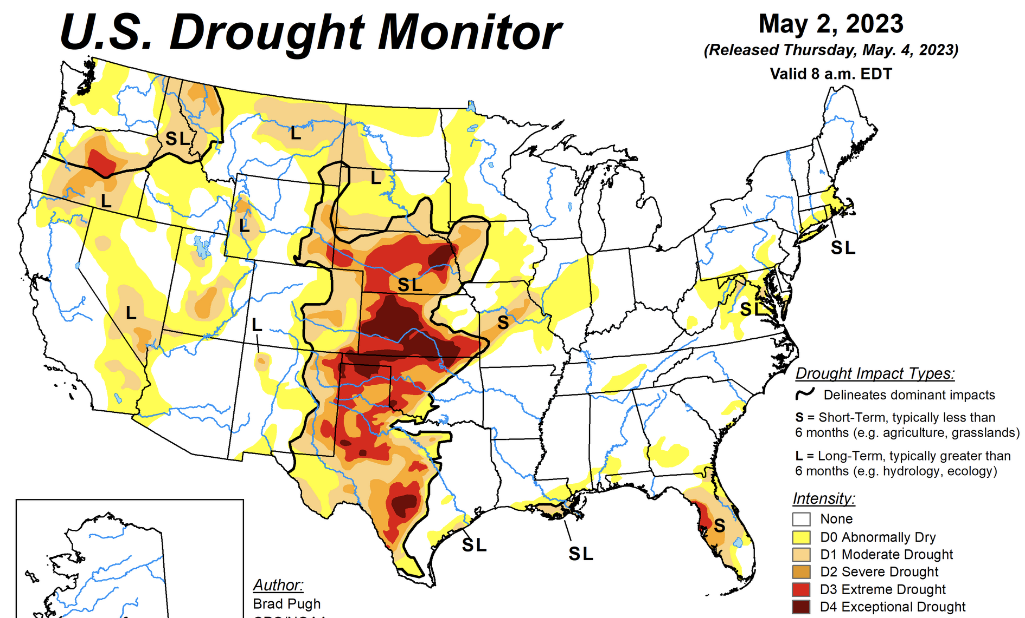
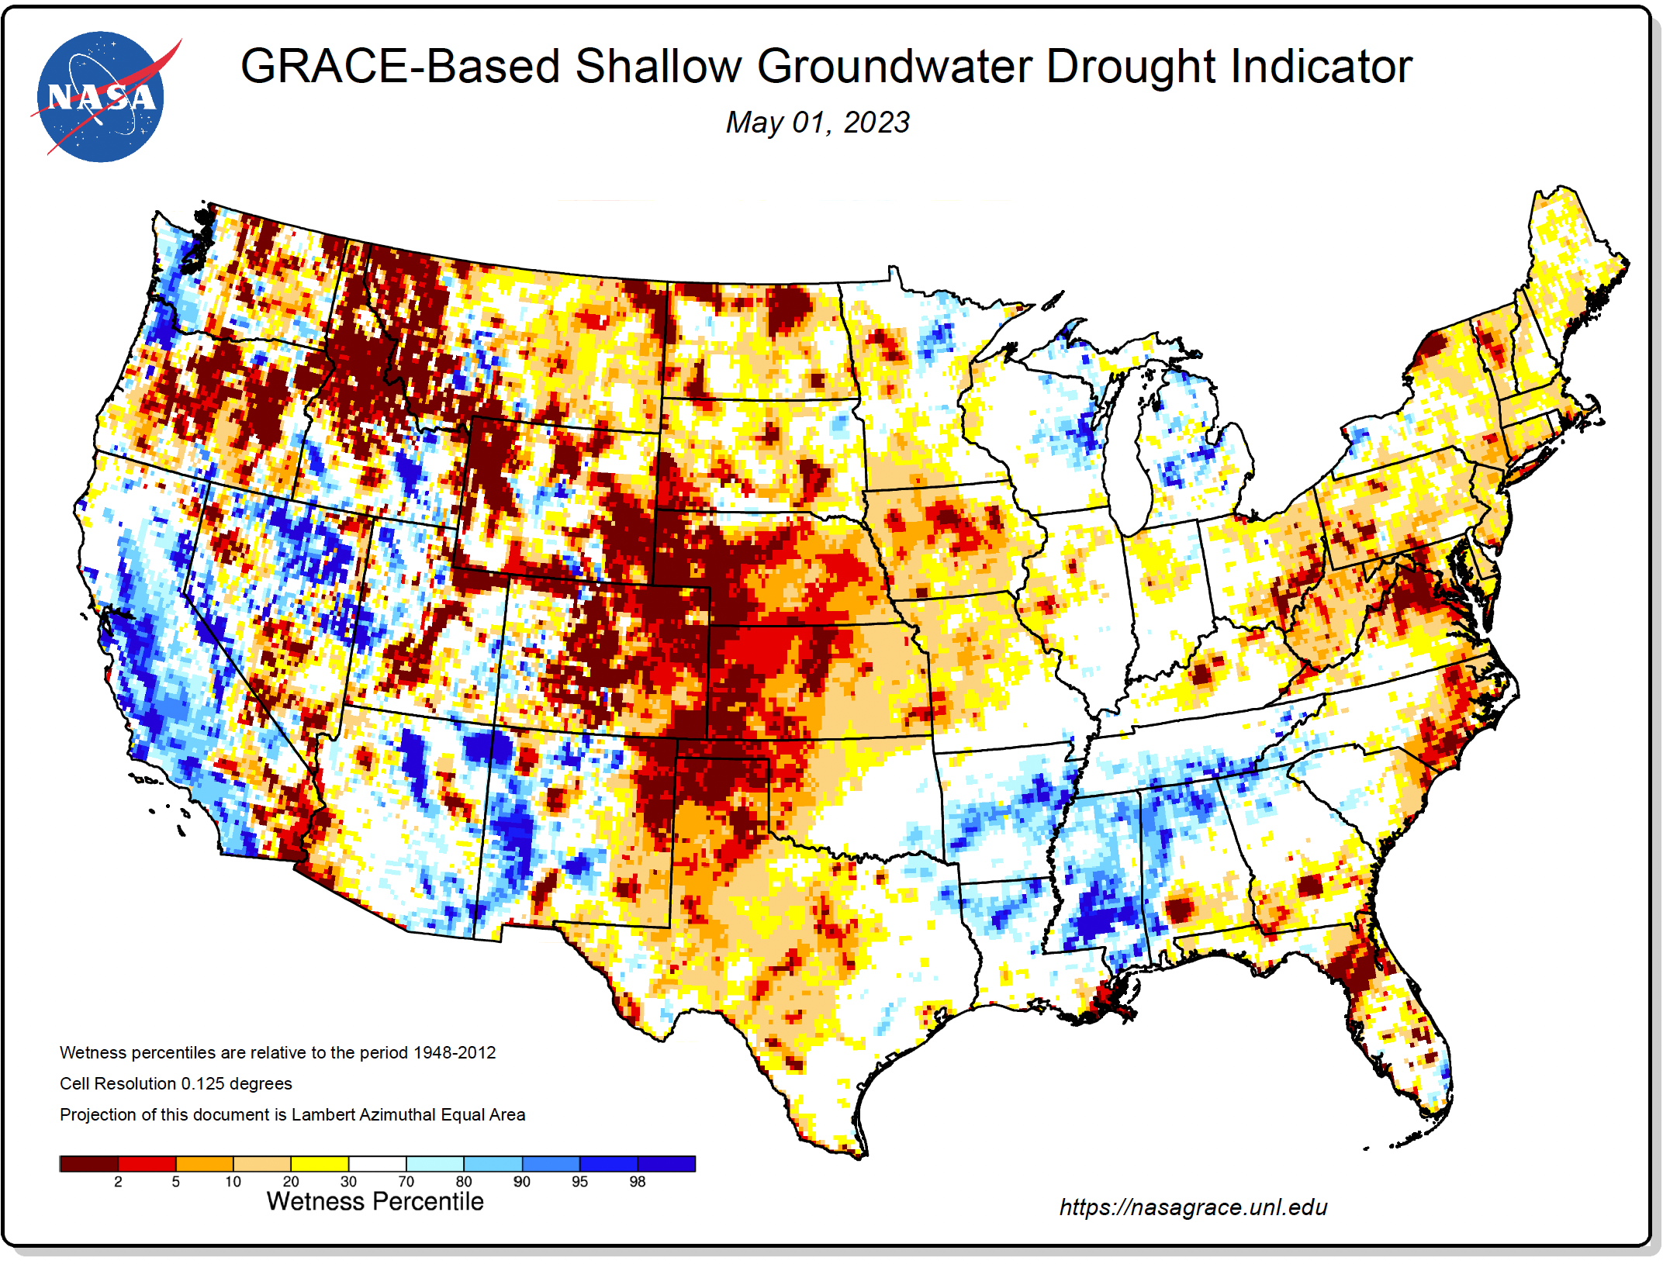
Western Water Crisis
U.S. Drought Monitor: Following three years of historic drought, a record Winter deluge temporarily improved the Western drought situation in early 2023.
Severe groundwater depletion in CA Northern and Central Valley –- where cities and farmers vie for water access – was also reduced. However, floods destroyed some farms, and not all rain water was captured.
Climate-induced droughts, heatwaves and floods are the new normal: more frequently responsible for production shortages and rising food prices.
Western States Where Crises Persist:
Precipitation gave only partial relief on the Colorado River system that provides water and electricity to 40 million customers in 7 states. Rains lifted Lake Powell from 20% to 30% capacity. The Bureau of Reclamation will continue to hold water cutback talks with 7 states (the most severe cutback proposed was AZ -21%).
Wells in the Ogallala Aquifer pump out water for agriculture nine times faster than rainfall replenishes it. Kansas set water use restrictions.
The NIB Provides $400 billion for new water supply projects: piped water importation, desalination, reservoir rainwater capture, primary water, water recycling, and irrigation and agricultural conservation.

Slide 13
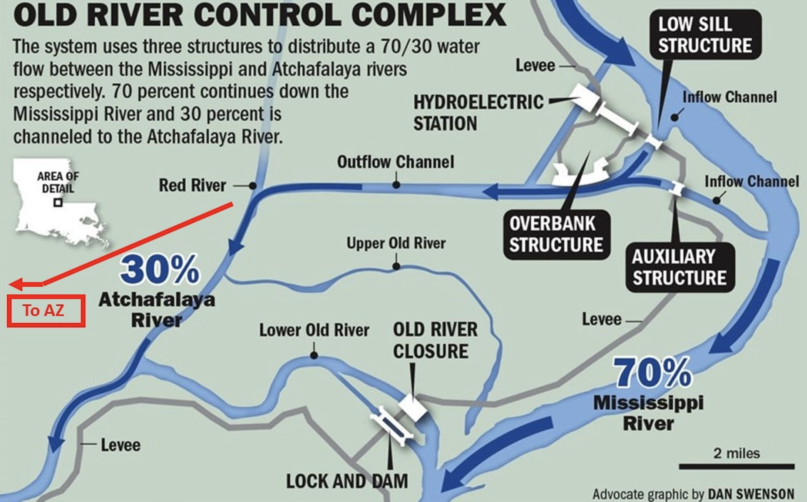
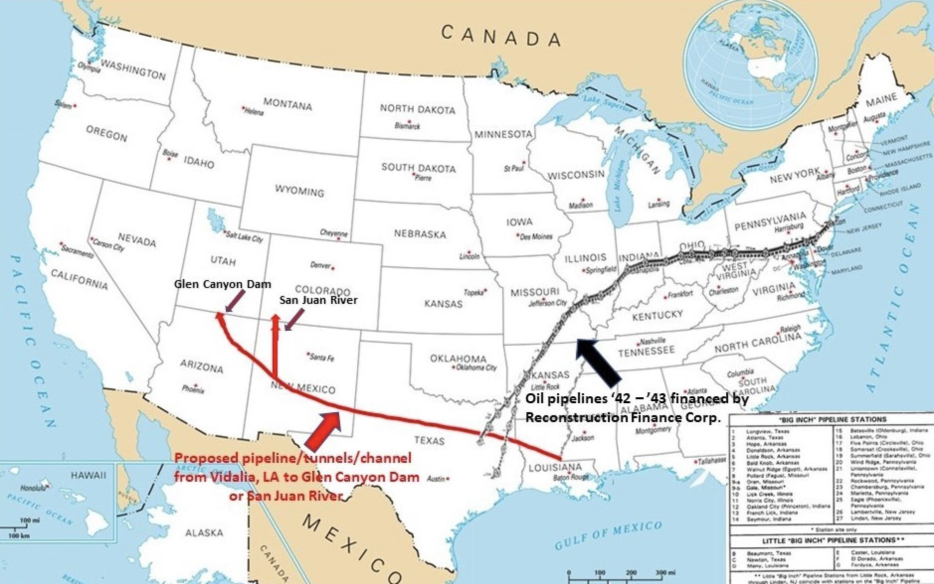
Permanent Solution for the Colorado River
At 30% capacity after Winter rains, the Colorado River System could still go to Deadpool Status (no water goes over the dams) in just a few years time. No amount of conservation can redress this. A permanent emergency solution is needed.
One proposal is to pump water from the Achafalaya River in LA, to the San Juan River in NM, that feeds into Lake Powell. Taking just 5% of LA’s excess water could fill Lakes Powell and Meade to 60% capacity in 1 year + nine months. Pipeline could be built in a year (like WWII oil pipelines). Cost around $15-20 billion, plus costs to pump water by renewable power. Would protect water and electricity supplied to residents in 7 states, plus $30 billion per year in food produced in the region.
Other proposals include rainwater capture in CA, and primary water extraction in low density areas like AZ, NM, and TX (cost $1 million/well).

Slide 14

NIB Helps Low Income Communities, Women, and
Minority Owned Businesses
Scale of investment creates 25 million family sustaining jobs.
Requires Davis Bacon Wages. Job training for skilled professions.
Builds equitable infrastructure; better-planned cities.
Fair access to jobs for minorities and women. Enforcement.
Targeted share of projects for Disadvantaged Business Enterprises, regions via the Clyburn 10-20-30 Rule, and Tribal Areas.
Trust Fund grants for low income rural and urban communities.
Builds needed affordable housing linked to public transportation.
Best plan for Equitable Economic Growth.
10 million working families in the United States are not making enough money to cover basic household expenses; a disproportionate share -- 1 in 3 -- are minorities.

Slide 15
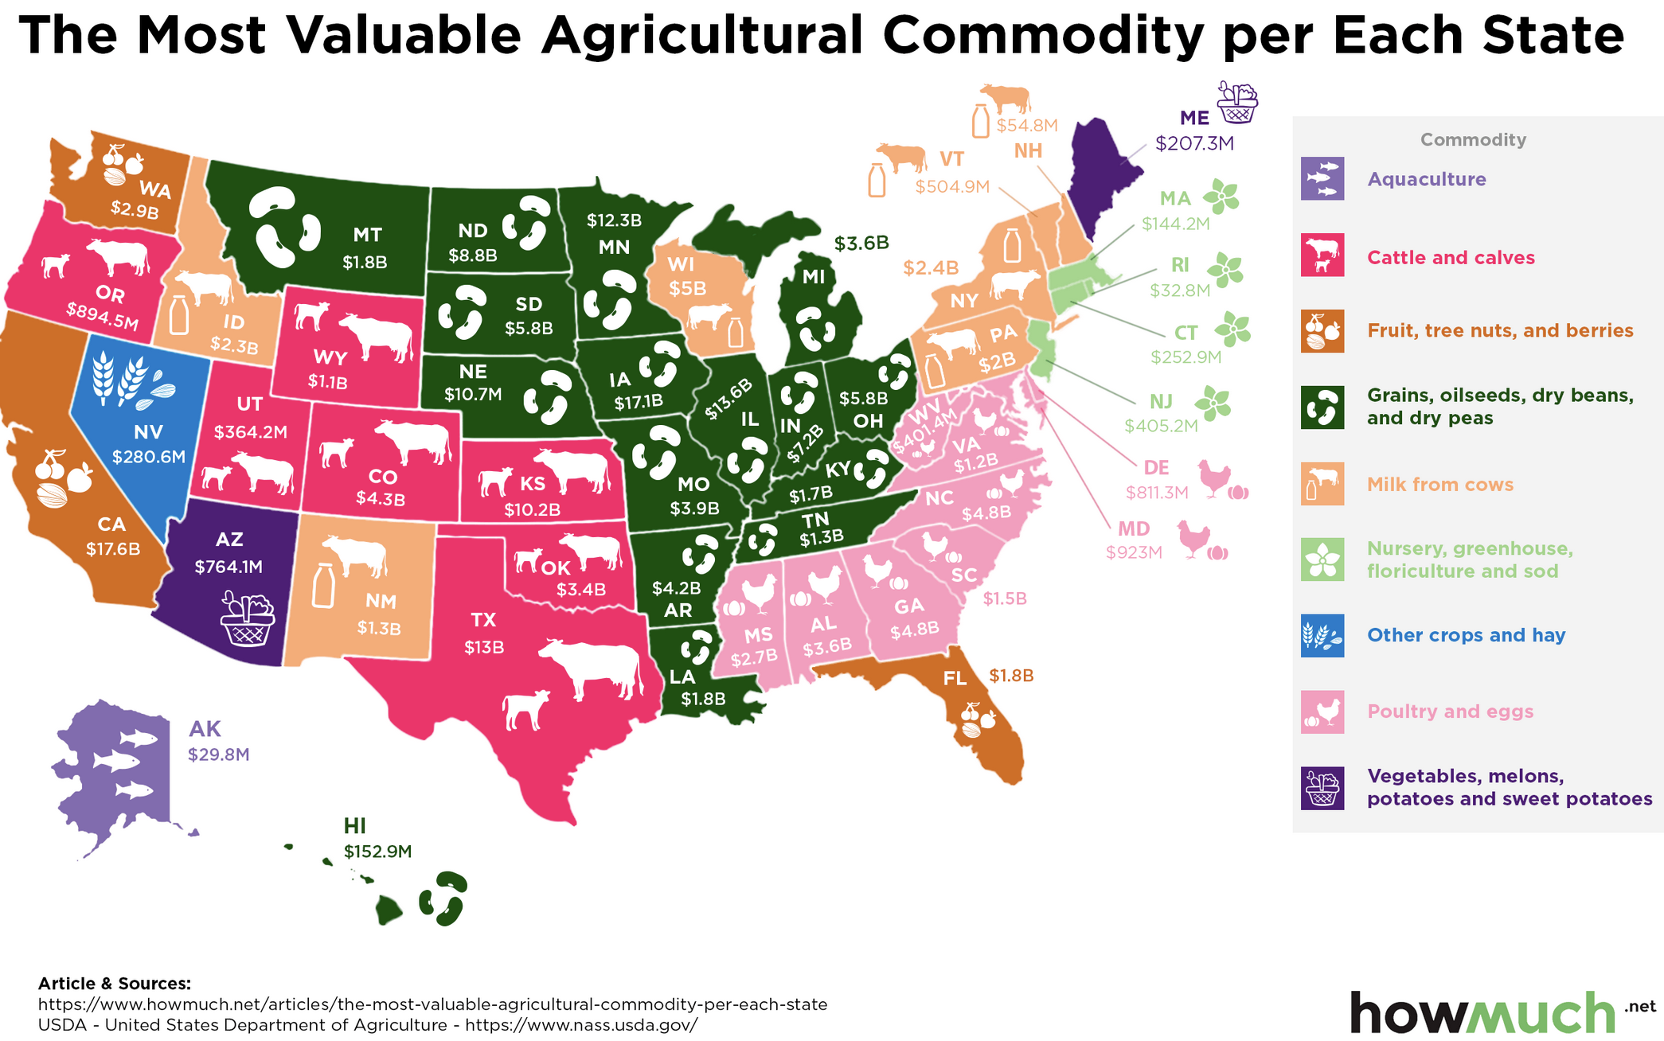
NIB Financing for Farmers and Rural Areas
Water Infrastructure + Water Management:
$800 B for drinking water, sewer, and stormwater systems.
$400 B for Mega Water projects to address drought: water redistribution, desalination, capturing precipitation in local reservoirs, and irrigation and agricultural conservation.
Connecting Rural America:
Improved local roads and bridges, and inland waterways, to move agriculture goods to market.
Affordable broadband everywhere, to improve farm technologies, tourism, and provide tele-education & health.
High Speed Rail to transport workers / stimulate local growth / improve local municipality revenues.
Electric Grid Resiliency. Renewable energy grid overlay.
Equitable Community Development:
Create millions of local, family sustaining jobs.
Complements rural prosperity initiatives in Rural Areas and Traditional & Native American regions. NIB Trust Fund.
Build schools and train workers in new industries.
Better Target USDA Financing, Combat Climate Change:
Will $28 billion for regenerative farming pass in next Farm Bill?
Top Agricultural states in 2019 were: CA, IA, IL, TX, MN

Slide 16

Training Workers
Union Apprenticeship Programs: National Association of Building Trades and other unions provide registered apprenticeships that train workers for good-paying jobs, allowing them to earn while they learn. Also Helmets to Hardhats and Trades Orientation Program.
Federally Financed Training Programs, Career One Stop, Jobs for Ex-Offenders Workforce Innovation & Dept. Labor
Community Workforce Development: Rhode Island Workforce Development after COVID, Los Angeles’ Workforce Development Board, Michigan’s Future for Frontliners, Chicago’s Green ReEntry, and Pennsylvania’s Keystone Development Partnership.
Community Community College Technical Degrees: 2 year degree in Electrical and Power Transmission earns $80,000 in first year, or more than twice the median income of a bachelor’s degree. 34% of Federal education grants now go to 2-year colleges. Study finds better coordination needed.
Career and Technical Education: NY City’s vocational high schools, and CT Technical Education and Career System, provide blended courses in technical fields.
New Supply of Workers coming from:
Low paying service jobs (replaced by robotics)
Working age workforce dropouts (3 million)
Underreported and rising unemployed
Ex-Offenders; Ex-Military; Immigration reform

Slide 17
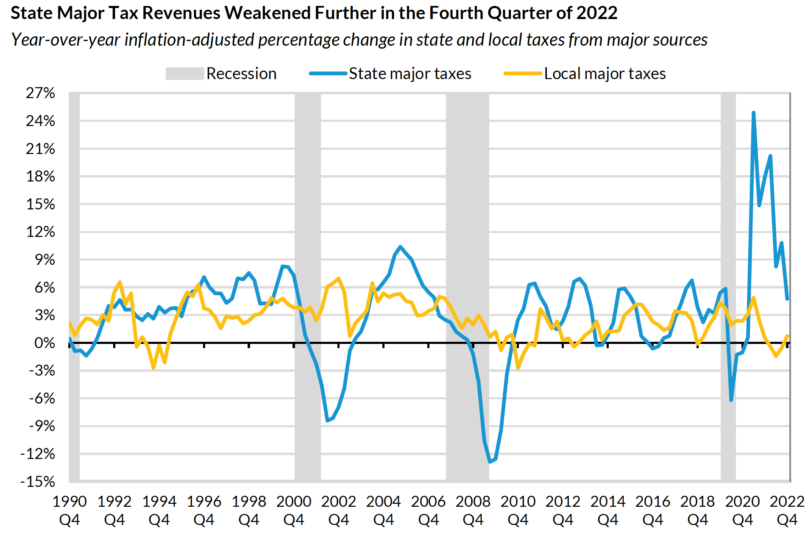
Can States Repay NIB Loans? ABSOLUTELY!
The NIB Provides Flexible Lending
Low interest rate loans; long maturity
Loans repaid out of user fees or general revenues
NIB Operations Supercharge Economic Growth / Improve Local Economies
GDP growth will average 5% per year (up from anemic 1.8% per year pre-COVID)
State and local governments will capture 9 cents of every new dollar added to the economy
NIB projects can ramp up hiring during recessions
Affordable housing projects raise nearby property values
Utility improvements improve utility bottom lines
Public transit projects yield 5 to 1 economic return
Example of FDR’s Reconstruction Finance Corporation
Lent to poor areas – rural electrification
All loans repaid
Local economies improved dramatically
In general, state revenues (blue) are generated by sales and income taxes that cycle up and down with recessions. Local revenues (orange) accrue from real estate taxes, and cycle with real estate bubbles.
State Tax Revenues Still Strong, But for How Long? By Lucy Dadayan, Urban Inst. Aug. 2022. And, State Tax and Economic Review, 2022 Quarter 4, By Lucy Dadayan, May 17, 2023.
Subtitle
Continued Weakness and Variability in State Tax Revenues
Lucy Dadayan
Display Date
May 17, 2023

Slide 18
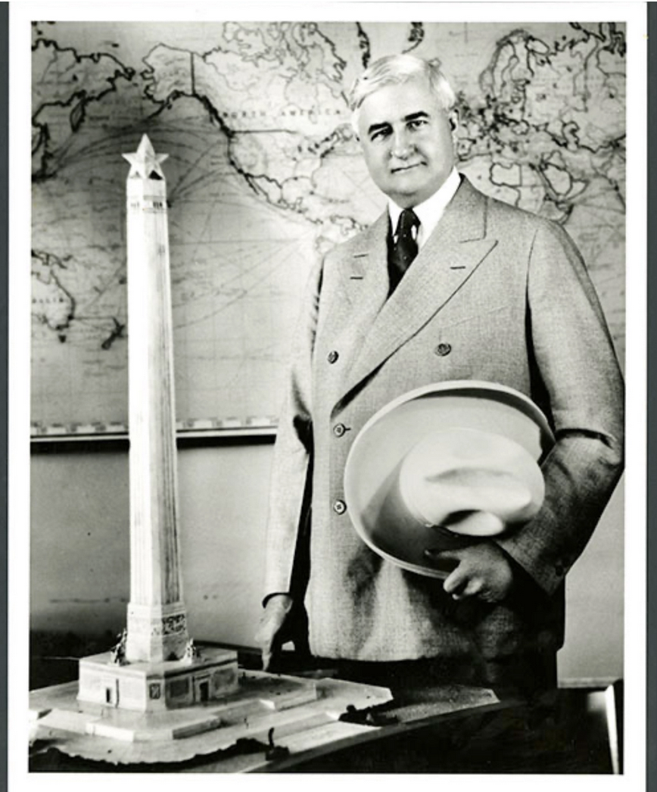
How is the NIB Managed to
Roll out Loans Effectively?
The Bill (= the Bank’s Charter) sets out the parameters for loans:
Targets infrastructure that engineers say we need. Adds HSR, broadband, water to grow food, and affordable housing.
Cost-benefit analyses justify loans. Seeks minimal environmental impact.
Tops up and does not duplicate ongoing government and local spending.
Uses Same Fiduciary Rules as any Commercial Bank
Board of Directors approves loans in accordance with Charter.
Loan and risk officers monitor for loan compliance.
Full transparency. Audits. FDIC insured. Inspector General.
Operations modeled on the Reconstruction Finance Corporation that got us out of the Great Depression and won World War II
Back office engineers help local governments formulate loans.
Employs innovative engineering techniques to create efficiencies, standardize operations, and lower construction costs.
Builds large, transformative projects like electrification, communications, high speed rail, and water mobilization.
Uses best management practices, with full transparency, to ensure projects are delivered on time and on budget, with no financial malfeasance.
All Four Previous Hamiltonian Banks were hugely successful and built most of America’s infrastructure!
Jesse H. Jones was a model banker, manager, and philanthropist. “He was flawlessly ethical: In his years as chairman of the Reconstruction Finance Corporation during the Great Depression, he distributed $50 billion in low-interest loans without a whiff of scandal.”

Slide 19
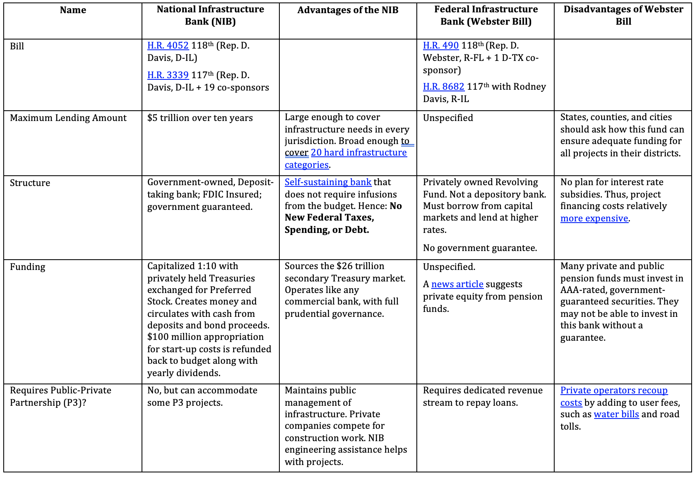
Side-by-Side Comparison of Bank Bills
* Last updated June 16, 2023.

Slide 20
NIB is a better way to fight inflation, save jobs, and curb a recession !
Proven Solution: Use National Infrastructure Bank to “Lean” Against Recession
Lends only to real sector. Sized at $5 trillion over 10 years to fix entire backlog of infrastructure projects. Start with shovel-ready projects like Jackson, NY, and CA.
Creates 25 million new family sustaining jobs. Grows businesses.
Short and Long Term Solution for Growth and Inflation
Hires and trains unemployed workers, especially low-income workers who need jobs the most. Davis Bacon wages. Earn while you learn.
Prevents further food price inflation by increasing water supplies to SW (piped and primary water).
Helps resolve other supply chain problems (ports, trucking, housing).
Strong climate-change benefit: more rail in transportation mix saving on fuel, and renewable agriculture.
Scope & type of spending ($5T) sharply raises economic growth and productivity (efficiency), as proven by RFC during Great Depression and WWII.
Prevents a meltdown for small and medium businesses, and state and local tax revenues.
NIB complements budgets. No new Federal spending, taxes, or debt needed. It’s passable legislation.

Slide 21
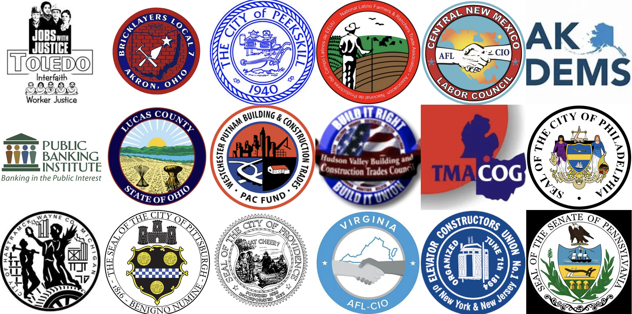
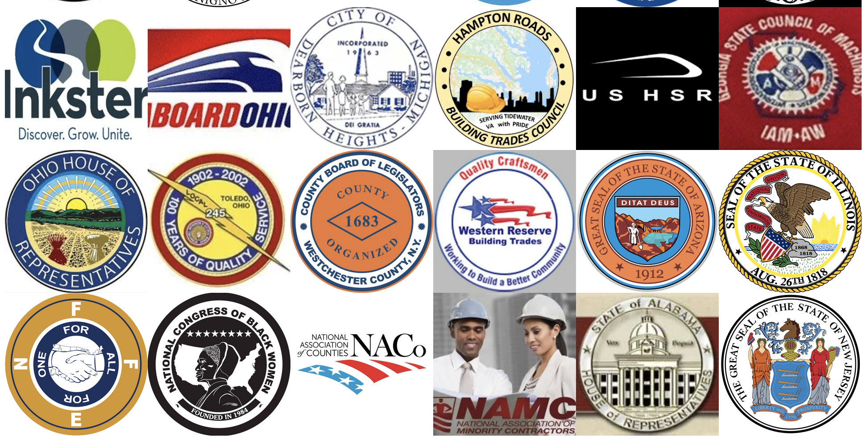
Endorsements from States and Organizations
Resolutions in Support of NIB Introduced in 25 State Legislatures:
Resolutions Passed in: Both Chambers: ME, NJ, NV, WA; One Chamber: CA, DE, IL, RI And in: Detroit, Los Angeles, San Francisco, Chicago, Philadelphia, & Pittsburgh

Slide 22
How You Can Help
Read More at: NIBCoalition.com
Ask Questions, or request a Presentation:
info@nibcoalition.com 571-432-7789
Sign an Open Letter / OP ED asking Congress to pass HR4052
Form a Grass Roots Campaign in Your Area:
Organize local legislators / workers / businesses
Formulate a Resolution for your City or County (samples on website)
Call or Write your Member of Congress to Pass HR4052:
U.S. Capitol Switchboard at (202) 224-3121
Make a donation at NIBCoalition.com – we are a low budget, all volunteer org.

Slide 23
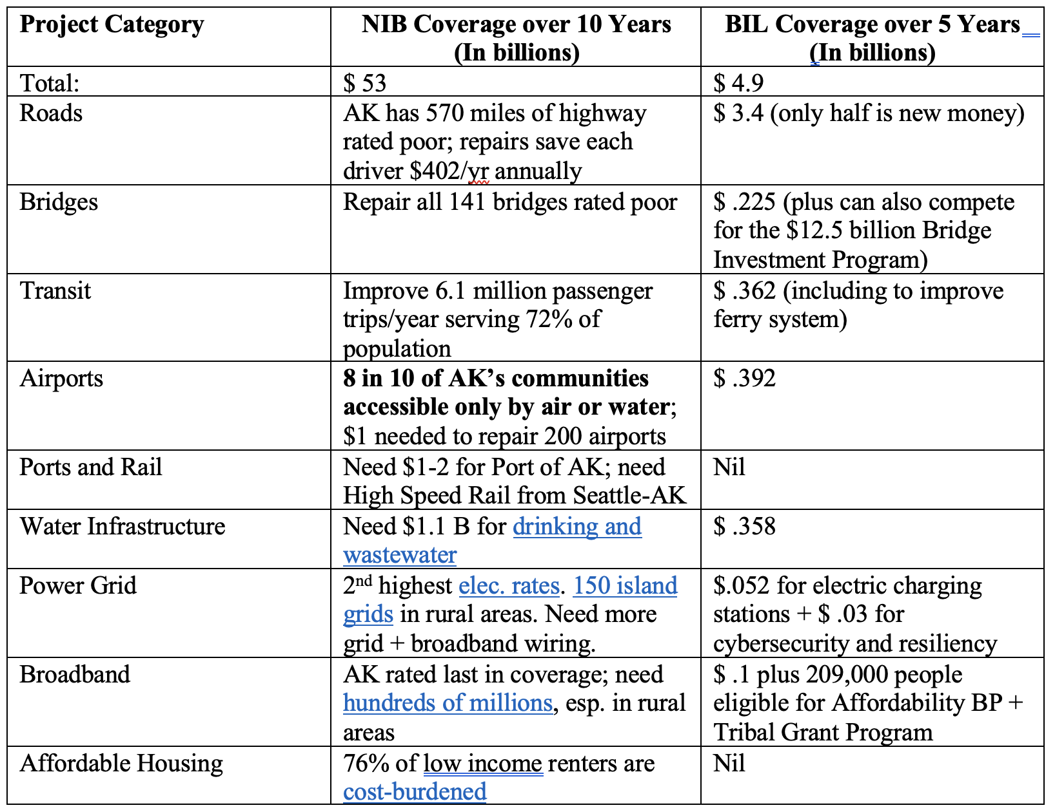
What’s in it for Alaska?
Infrastructure and the Economy:
With 16 percent of the U.S. landmass and less than 0.3 percent of its population, Alaska’s unique geography has driven infrastructure development. Affected by climate change / earthquakes.
Per capita income 11th highest in nation. Highest Tribal pop (20%). Economy reliant on oil & gas industry.
AK will receive the following from the NIB:
Up to $53 billion over 10 years, creating 266,000 new, family sustaining jobs. (Compared to $4.9 B from BIL)
Other Benefits from NIB:
Enhance education to train workers.
Improve state and city finances through economic growth, including to repay back loans.
Grants for low income areas.

Slide 24
What’s in it for Arizona?
Infrastructure and the Economy:
ASCE Infrastructure Report Card Grade C: Roads (D+), dams, levees, and drinking & waste water infrastructure ($8 billion needed) in poor condition. 32% of households lack high-speed broadband access. 20% of homes lack internet. Power grid needs expanding.
Growing population; large land mass; 20-year drought. 13% cutback in water allocation from CO River. 80% of land with few restrictions on water use. Groundwater drawdown is unsustainable. Now building restrictions.
AZ will receive the following from the NIB:
Up to $96 billion over 10 years, creating 480,000 new, family sustaining jobs. (Compared to $7.3 B from BIL)
Includes AZ share of $400 billion to deliver new water supplies. One option is piping 5% of water from Atchafalaya to CO Lake Powell, to refill 2 reservoirs in under 2 years (cost $15-20 billion). Then by existing aqueduct to Phoenix. Similar to Rep-Dem proposal in AZ legislature. Alternative is desalination (cost $5 B; delivers water at 10x normal water fee).
Connect cities with high speed rail.
Other Benefits from NIB (see separate slides):
Enhance education to train workers in new industries.
Connect/improve rural economies.
Improve state and city finances, business, and tourism, through economic growth.

Slide 25
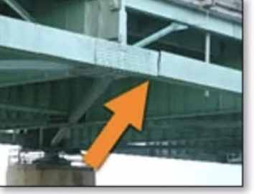
What’s in it for Arkansas?
AR’s Economy
Retail headquarters (Walmart), transportation, agricultural, fisheries, with some export manufacturing (aircraft, steel, petroleum)
Median household income $39,800 (49th); 19% population below the poverty line.
Aging infrastructure impedes economic growth
CNBC rates AK 41st out of 50 states for infrastructure (41st for educated workforce).
No ASCE Report Card for AR, But finds: 4.9% of bridges are rated structurally deficient. Drinking water needs $7.4 billion. 193 dams considered to be high-hazard potential.
Ranked 44th in U.S. for broadband access. Needs $550 million to deliver service to underserved and rural communities; got $53 million in 2023 for Arkansas Rural Connect program.
Arkansas will receive the following from the NIB:
Up to $48 billion over 10 years to cover all of the states infrastructure financing gap.
Creates 240,000 new great paying jobs, with Training.
Rebuilds critical roads & bridges; improves OK-AR-TN transmission line, rural broadband, and inland waterways.
Neighboring high speed rail will boost AK’s economy.
Cracked steel box beam on the Hernando de Soto I-40 bridge that connects Tennessee and Arkansas

Slide 26
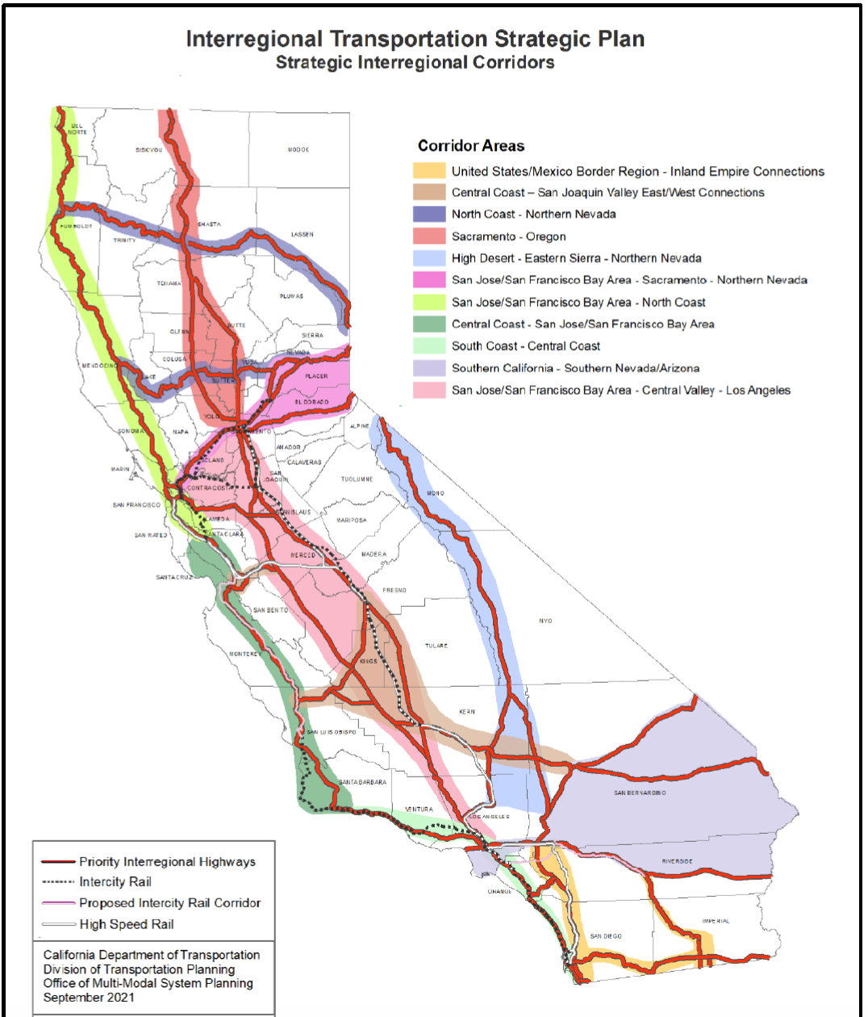
What’s in it for California?
CA 2019 Infrastructure Report Card Grade: C-
Grades of D for: Roads ($120 B needed), transit, energy, levees, drinking water, wastewater, and stormwater.
CA’s Economy
Largest in the U.S., boasting $3.4 trillion in gross state product (GSP) as of 2021. Largest sectors are: Finance/Real estate, business services, IT, manufacturing, & government.
$50 billion in agriculture production uses 80% of water supply.
High cost of housing driving emigration to AZ, NV, TX.
CA State will receive the following from the NIB:
Up to $588 billion over 10 years to cover all of the states infrastructure financing gap. (Only $46 B from IIJA.)
Fully finances High Speed Rail and transit and commuter rail, to address traffic congestion and reduce CO2 emissions.
Expands/hardens grid to move renewable energy where needed.
Affordable housing linked to transit, for housing insecure.
Rebuilds critical water systems, roads & bridges; expands ports and inland freight connections.
Solves drought for residents and farmers.
Creates 2.9 million new great paying jobs for CA families struggling to stay afloat.
Caltran’s (CA DOT) 2021 Interregional Strategic Plan for priority roads (in red), intercity passenger rail (dotted), and high speed rail (double black lines). (Excludes freight rail.)

Slide 27
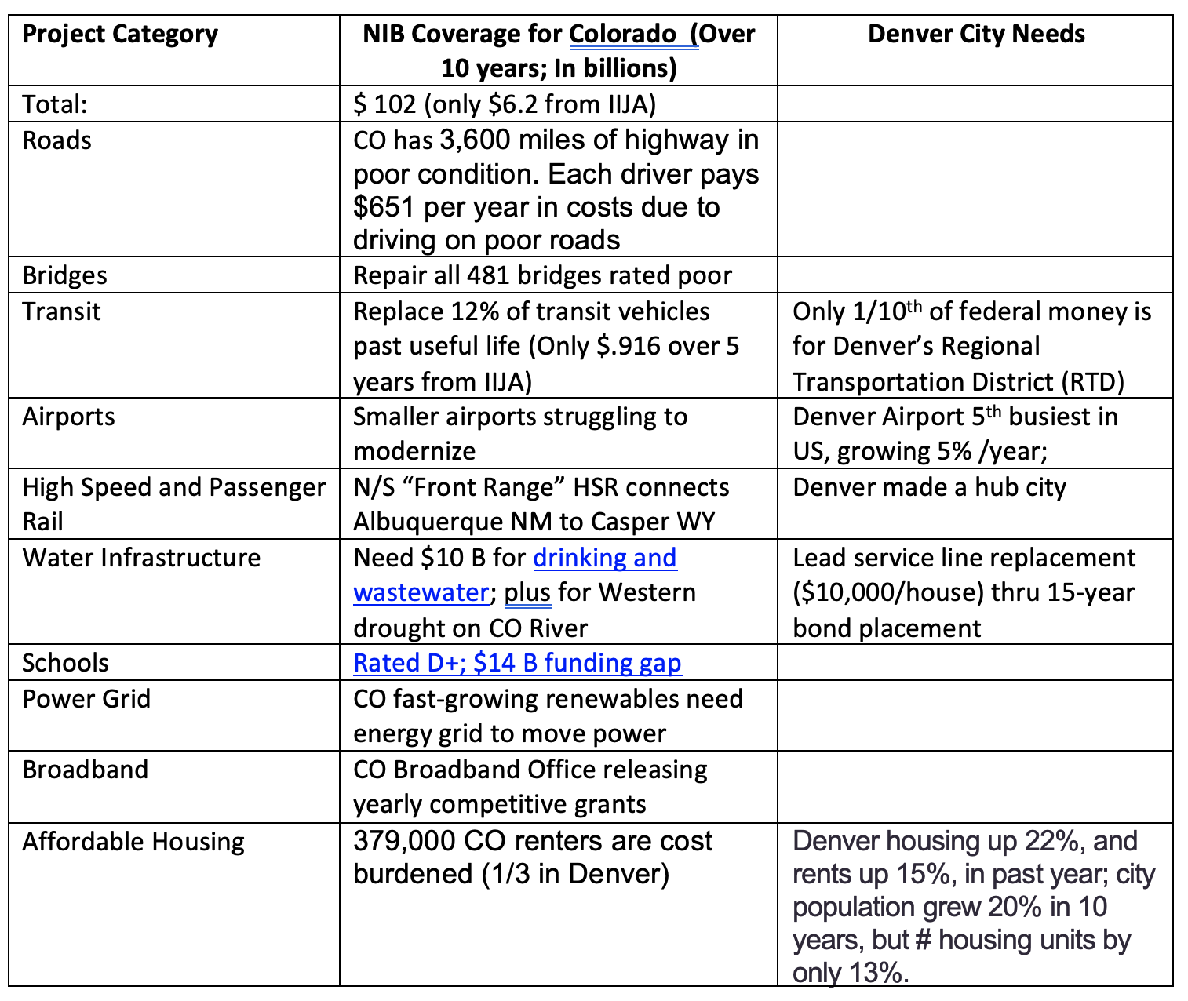
What’s in it for Colorado?
CO will receive the following from the NIB:
Up to $102 billion over 10 years, creating 512,000 new, family sustaining jobs. (Compared to $6.2 B from IIJA)
Other Benefits from NIB:
Build affordable housing to complement Denver Plan
Solve long-term drought and water problems
Stimulate business thru Buy America, like Pueblo’s rail production using renewable energy.
Improve state and city finances through economic growth, including to repay back loans.
Enhance education to train workers.

Slide 28
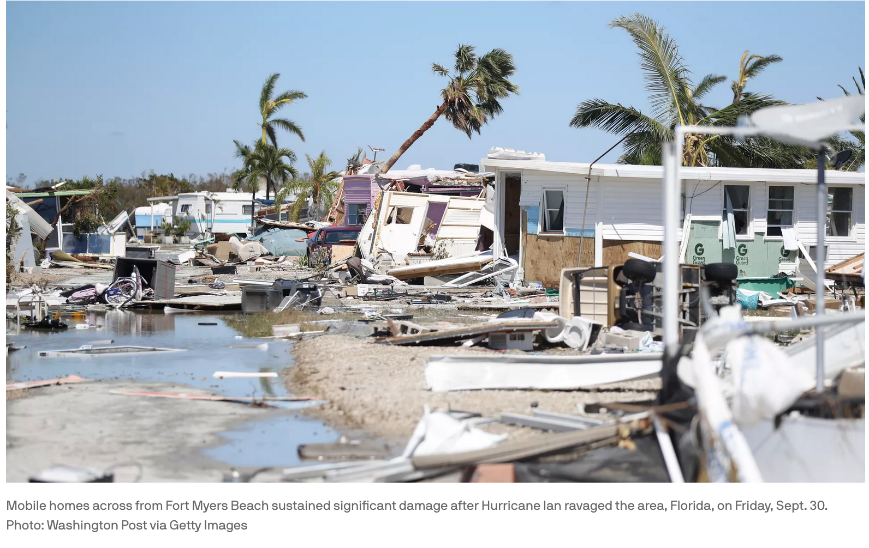
What’s in it for Florida?
2021 ASCE Report card gave FL grade of C: 31% of major roadways and 3% of bridges are in ‘poor’ condition; dams and levees graded D-; only 40% have been assessed for risk.
State will receive the following from the NIB:
Up to $272 billion over 10 years, creating 1.36 million new great paying jobs. (Only $19 B from IIJA; limited, short-term FEMA relief)
Full financing for big ticket items like: infrastructure resiliency & storm surge protection. Great planning incl. “Dutch Dialogues,” used by New Orleans / Charleston SC.
Affordable housing needed before & after Ian.
Direct financing for, complete broadband, schools, local roads, stormwater, drinking water and sewer systems, ports, and high speed rail.
Bundle projects. Promote rural development.
Enhance education to train workers in needed fields. Ex: “Earn and Learn” trade programs.
Improve state and county finances through economic growth and recovery.
Scores of people lost their lives, record storm surges swamped coastlines, and 2.6 million were without power after Hurricane Ian pummeled Florida's western coast, then barreled through the Carolinas on Sept. 26-30, 2022.

Slide 29
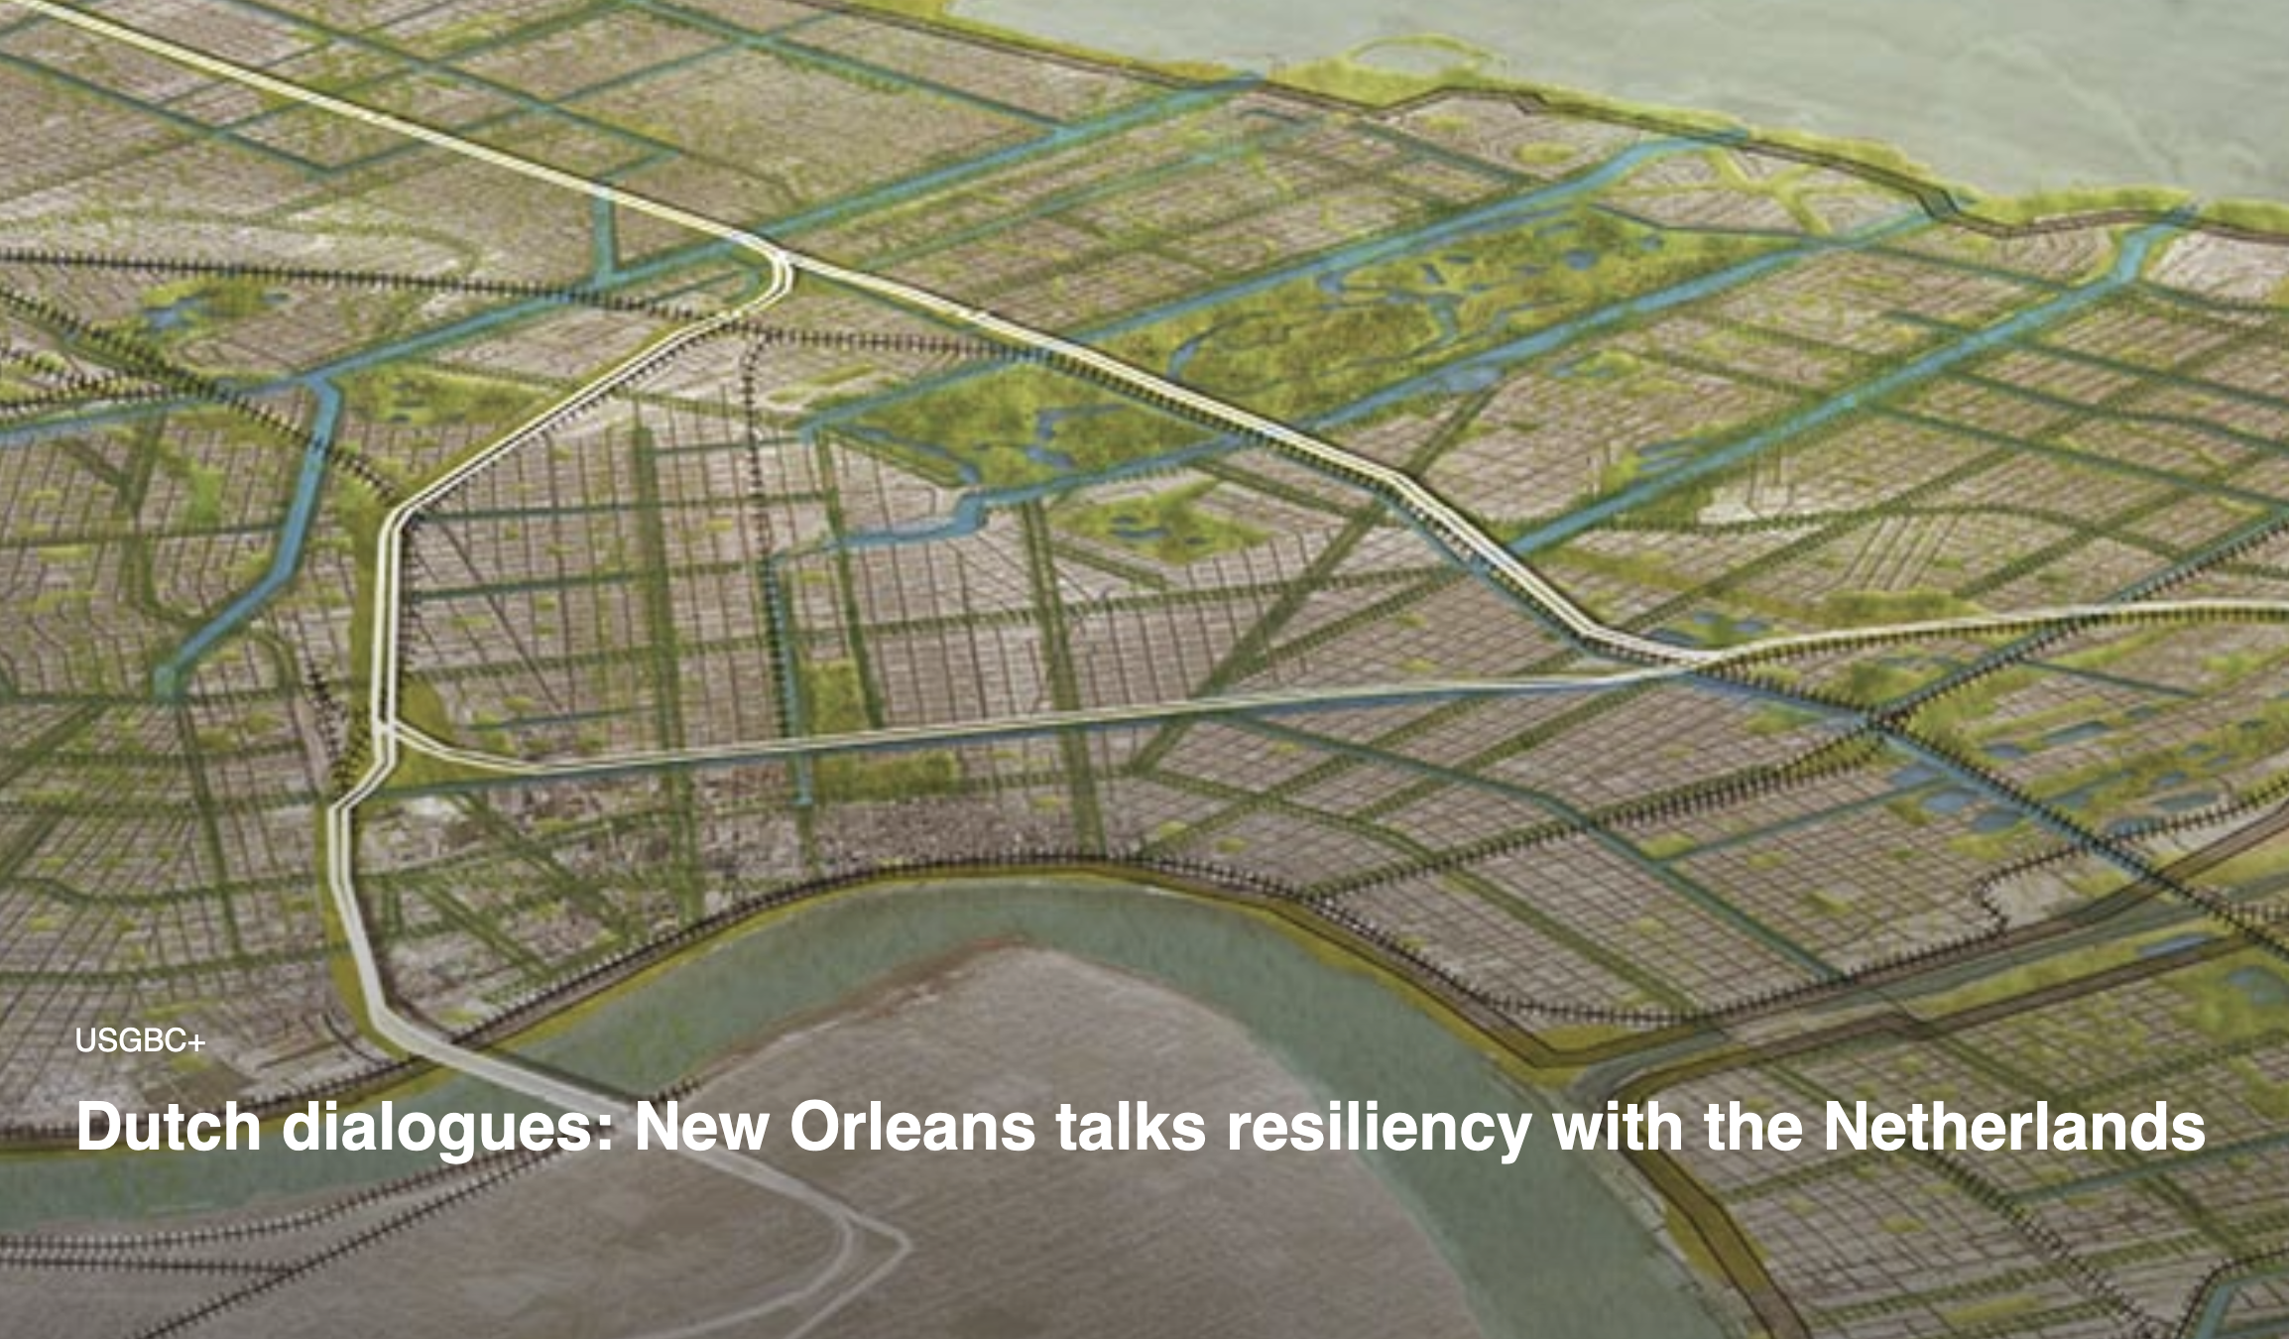
Louisiana – Example of Building Resiliency
2017 ASCE Report card gave LA grade of D+: with D grades for roads (25% in poor condition), bridges (13% structurally deficient), inland waterways, and coastal areas (levees protect 2.4 million residents and $155 billion of property). Subject to hurricanes.
State will receive the following from the National Infra. Bank:
Up to $75 billion over 10 years, creating 350,000 new great paying jobs. (Only $8 B from IIJA)
Full financing for big ticket items like: power grid resiliency, water management to protect against repeated storm damage, inland transportation connecting ports, and high speed rail.
Direct financing for, complete broadband, schools, local roads, drinking water and sewer systems, ports, affordable housing, and rural development.
Bundle projects (stormwater tunnels with buried power lines). Layer improvements (“grey” construction with wetlands).
Enhance education to train workers in needed fields. Ex: “Earn and Learn” trade programs.
Much needed economic growth Improves state and county finances .
Great planning with adequate funding needed to make New Orleans’ infrastructure even more resilient.

Slide 30
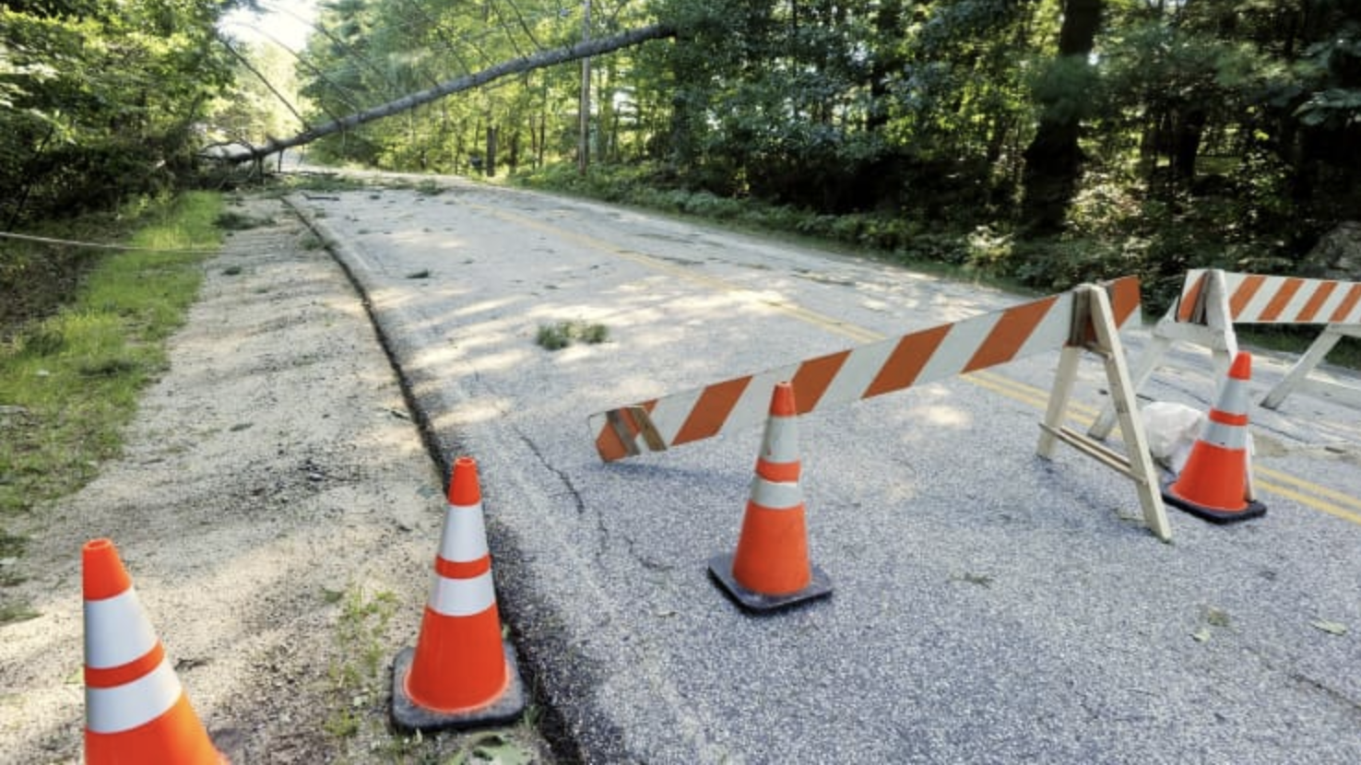
What’s in it for Maine?
State will receive the following from the NIB:
Up to $26 billion over 10 years, creating 132,000 new great paying jobs. (Compare: Only $3 B from IIJA.)
Direct financing to address: frequent power outages. broadband affordability. limited air travel options, poor roads and bridges (23% and 13%, respectively), mass transit, bridges (13% structurally deficient), schools ($304 million funding gap), drinking and waste water systems ($1.2B needed over 10 years), enhancements at 2 major ports, and affordable housing.
Bundle projects. Promote rural development.
Enhance education to train workers in needed fields.
Improve state and county finances through higher economic growth.
In 2021, CNBC rated ME worst state for infrastructure. Frequent power outages were a major reason.

Slide 31
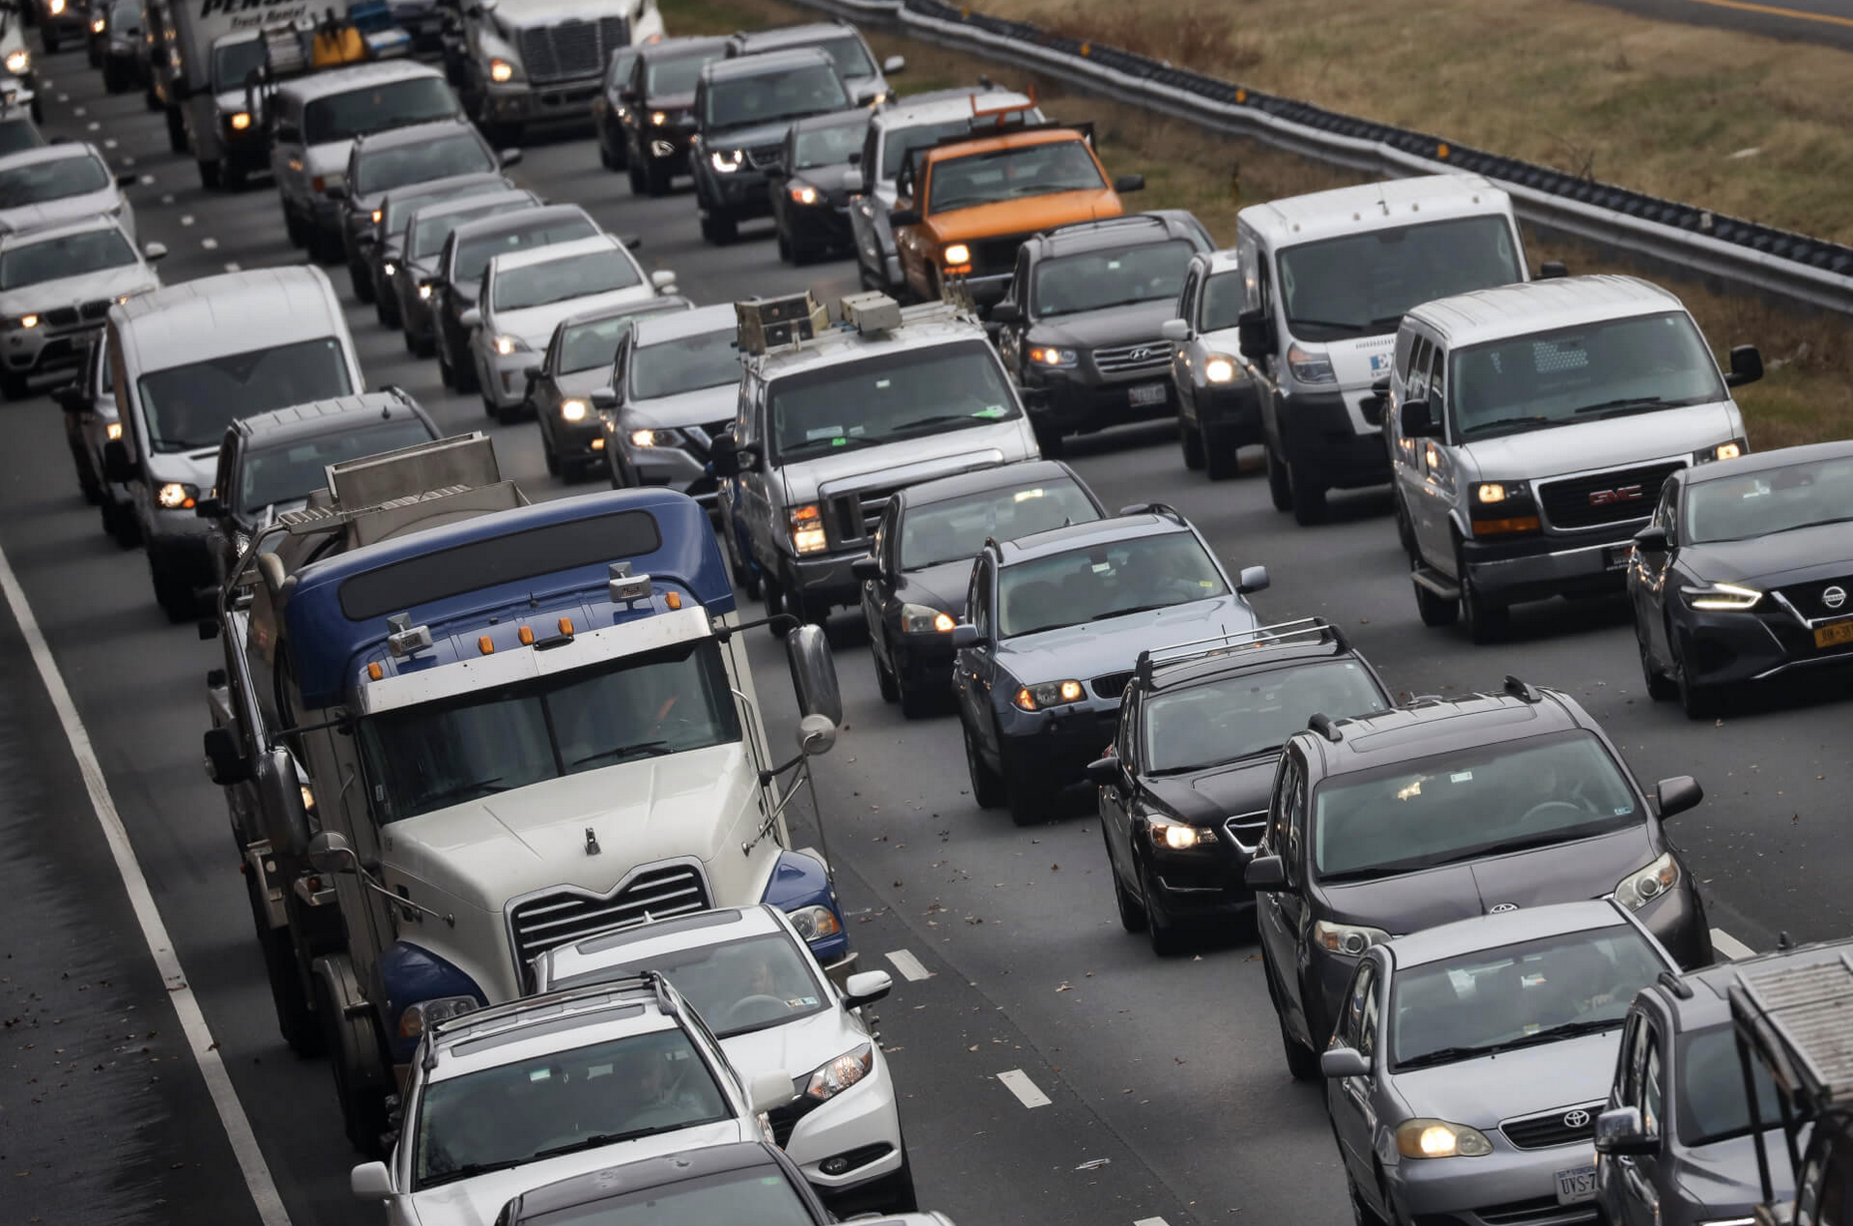
What’s in it for Maryland?
MD State will receive the following from the NIB:
Up to $78 billion new money over 10 years. (Compared to $7.4 B only from the IIJA.)
Creates up to 390,000 new, family sustaining wage jobs. Buy America provisions to promote American manufacturing.
Improve all areas identified in ASCE Report Card Grade C: transit (D+, 104 million annual unlinked trips), roads & bridges (congestion on 15% of freeways; 27% roads & 5% bridges in poor/risky condition), drinking and wastewater ($9.8 B over 10 years needed; E.coli in Baltimore’s water; lead pipes), energy (power outages), expand Port of Baltimore (9th largest in US).
Keep public infrastructure in public hands – limit P3s.
Cities and Rural Areas would get:
Build Northeast Corridor (NEC) high speed rail. Build affordable housing linked to transit.
Enhance education to train workers in needed fields. Ex: LIUNA trade apprenticeship programs.
Promote inner-city community development. Connect rural areas. Reduce poverty.
Opinion: Plans to Privatize Maryland’s Highways with Toll Lanes are Not in the Public Interest
By Guest Commentary July 14, 2022

Slide 32
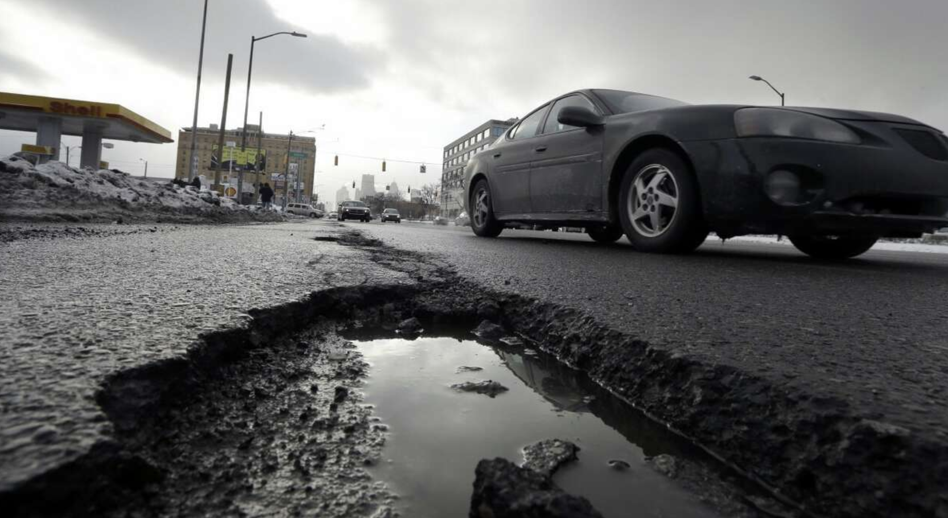
What’s in it for Michigan?
MI State will receive the following from the NIB:
Up to $128 billion over 10 years to cover all of the states infrastructure financing gap. (IIJA only $11.1 B new money)
Spending would create up to 638,000 new, family sustaining jobs, with Buy America provisions to promote American manufacturing.
Full financing for big ticket projects like: Chicago-Detroit-Toronto high speed rail. Replace ALL lead service lines incl. Flint and Benton Harbor.
ASCE 2018 Report Card D+ for infrastructure (D- for roads; 11% of bridges structurally deficient).
Direct financing for: schools ($1.3 B gap), local roads, stormwater, drinking water and sewer systems ($7.5 B gap), affordable broadband, and affordable housing. Complements MI homelessness program.
Rebuild Detroit (#1 neediest city) where 1 in 5 families faced eviction in 2022. Transport workers efficiently to jobs.
Enhance education to train workers in needed fields. Ex: LIUNA trade apprenticeship programs.
Improve state and city finances. Grow Businesses. Restore manufacturing. Create jobs, jobs, jobs.
Michigan has the third worst pothole problem nationwide. Each motorist pays $644/year in repairs. Feb. 4, 2022.

Slide 33
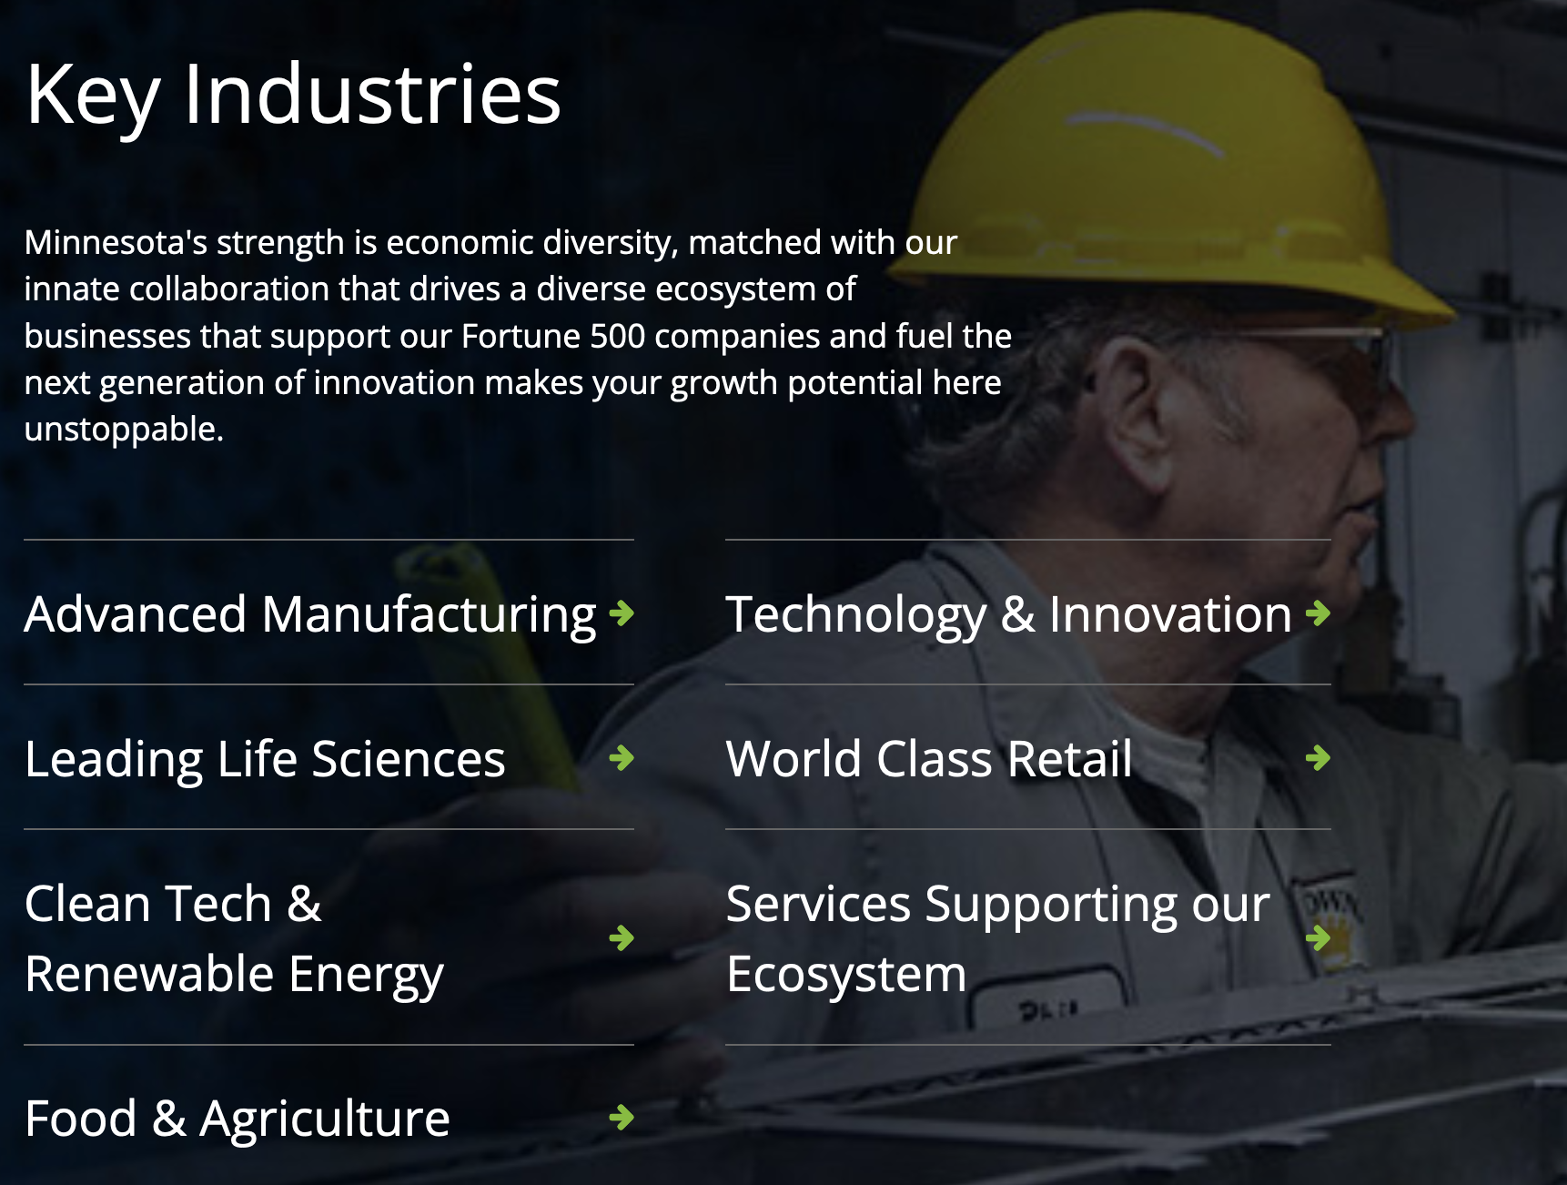
What’s in it for Minnesota?
Minnesota will receive the following from the NIB:
Up to $83 billion over 10 years (only $7 B from IIJA).
Create up to 414,800 new, family sustaining wage jobs, Buy America provisions to promote American manufacturing.
Full financing for big ticket projects that complement Minnesota’s diversified manufacturing economy. Includes expanded freight and high speed rail, expanding Minneapolis as an economic hub, improved inland waterways, and better inter-state coordination and investments to improve flood control.
Improve C grade on infrastructure. 10-year financing for: state roads underfunded by $9 billion; aging public transportation; Lake Superior ports; $3.8 billion for drinking water + $1.2 B for wastewater; $1.3 B for complete broadband.
Provide training for workers in needed fields. Ex: LIUNA trade apprenticeship programs.
Promote inner-city community development. And build affordable housing.

Slide 34
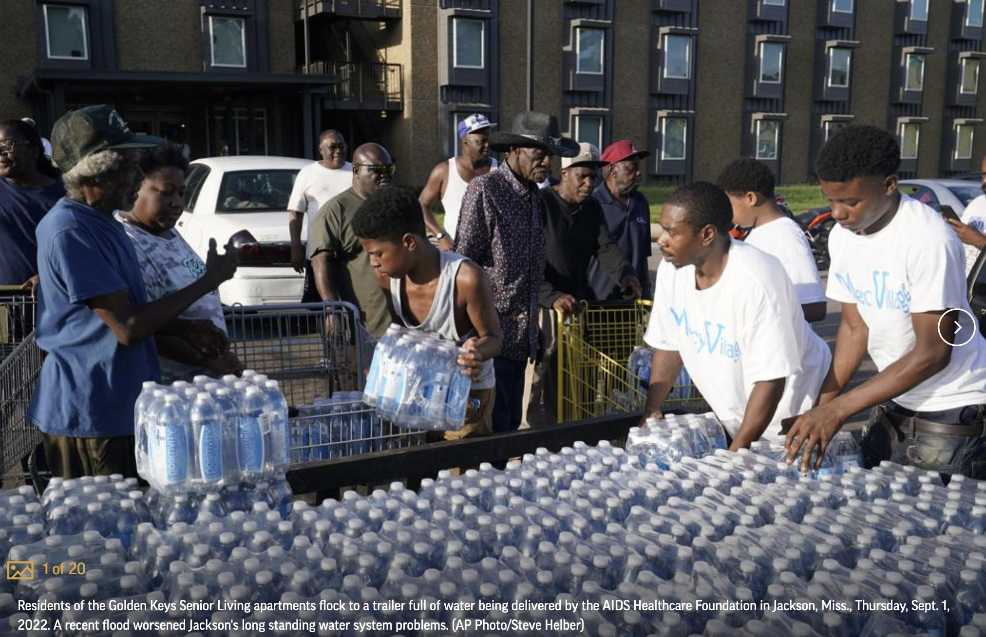
What’s in it for Mississippi?
MS will receive the following from the NIB:
Up to $47 billion over 10 years, creating 235,000 new, family sustaining jobs.
Of that, $2 billion for Jackson’s water treatment plant and pipe distribution system (Compared to $429 million for water from IIJA for entire state). Also, gets all the lead out.
Other Benefits from NIB:
Fix Roads (40% in poor condition), bridges (with a $1.6 billion funding gap), levees and dams (scores rated in unacceptable condition), affordable housing and broadband, public transport, and more.
Improve MS economy (lowest per capita in nation). Enhance education to train workers.
Improve state and city finances through economic growth, including to repay back loans. Trust Fund grants for poorest communities.
Mississippi capital’s water disaster developed over decades
By EMILY WAGSTER PETTUS, September 5, 2022

Slide 35
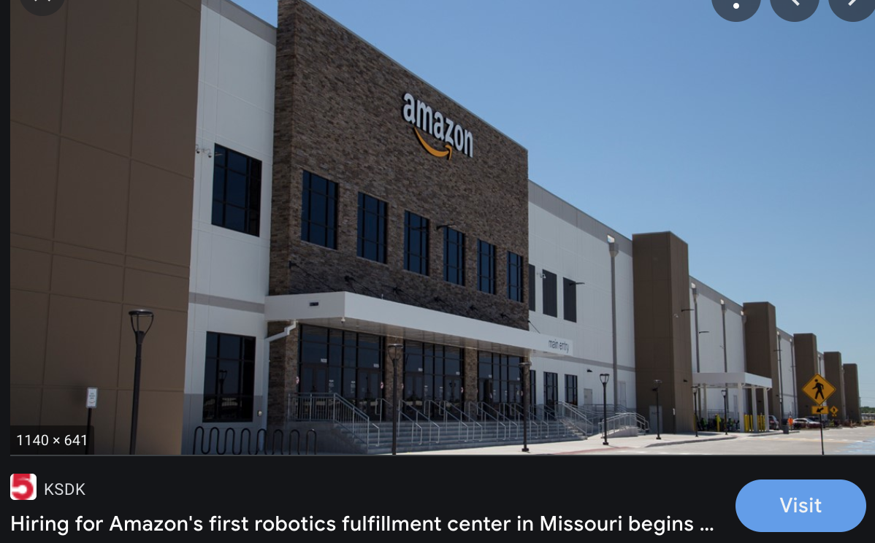
What’s in it for Missouri?
Missouri will receive the following from the NIB:
Up to $116 billion over 10 years (only $7 B from IIJA).
creating up to 582,000 new, family sustaining wage jobs, Buy America provisions to promote American manufacturing.
Full financing for big ticket projects that complement Missouri a leading transportation logistics hub. That includes expanded freight and passenger rail, improved inland waterways, and better inter-state coordination and investments to improve flood control.
Improve state and city finances through economic growth. Direct financing for: schools, to replace lead lines water service lines, fix: local roads, stormwater, and sewer systems, broadband in rural & urban areas.
Provide training for workers in needed fields. Ex: LIUNA trade apprenticeship programs.
Promote inner-city community development. And build affordable housing.
Missouri’s central location has long been a major logistics advantage. But, natural and long-held advantages can evaporate in the face of regional, national and global competition, especially if critical ongoing and new investments aren’t made.

Slide 36
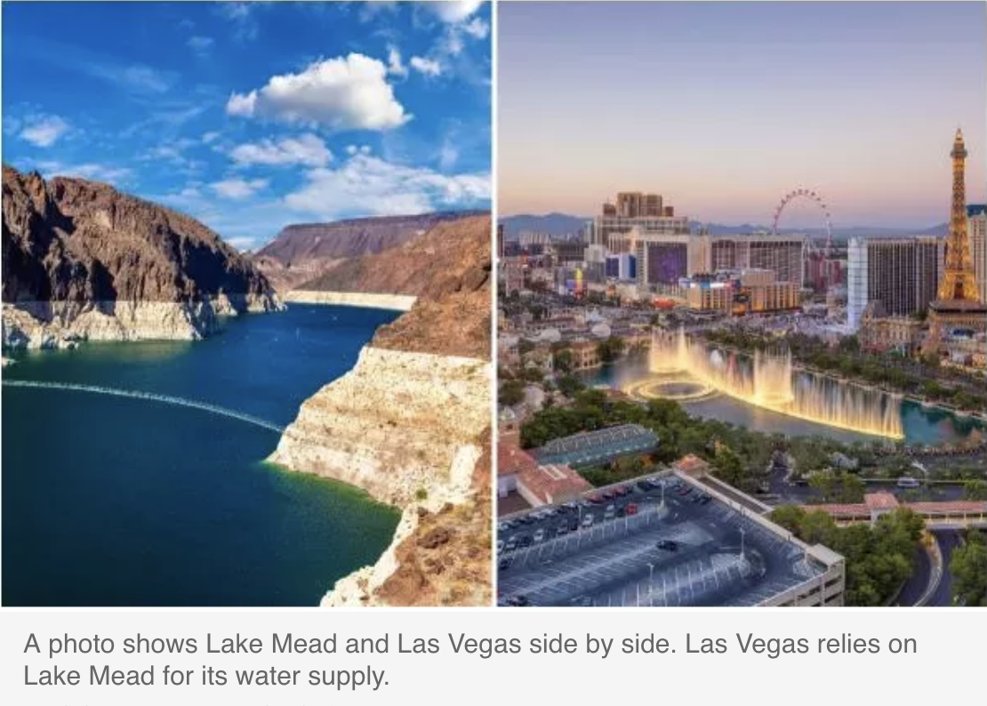
What’s in it for Nevada?
NV will receive the following from the NIB:
Up to $37 billion over 10 years for transportation, water, broadband, schools, and resiliency. Creates 185,000 new, family sustaining jobs.
Compare to $4.1 B from Bipartisan Infrastructure Deal (of which only $400 M for water; $100 M for broadband).
Water Infrastructure + Water Management:
Safe drinking water, sewer, and stormwater systems.
Mega Water projects to address Western drought: water importation, desalination, capturing rainwater in local aquifers, primary water, and irrigation and agricultural conservation.
Connecting the State:
High Speed Rail connecting: Reno-Las Vegas-LA; San Francisco-Reno-UT. Stimulates economic growth.
Affordable broadband everywhere, to improve farm/ranch technologies, and provide tele-education & health.
Improved local roads, bridges, and waterways, to move goods to market.
Electric Grid Resiliency. Renewable energy grid overlay.
What Will Happen to Las Vegas if Lake Mead Water Level Gets Too Low? Newsweek, 1/16/23. Hoover Dam would stop producing electricity for 30 million people, and Las Vegas would lose 90% of its water supply.

Slide 37
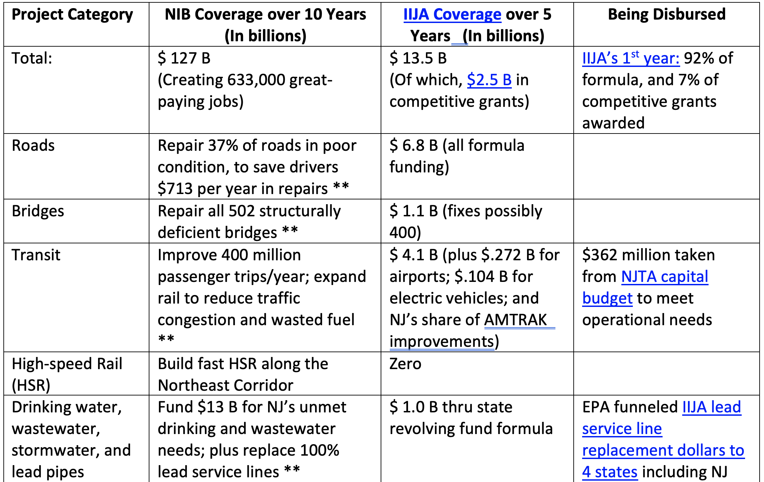
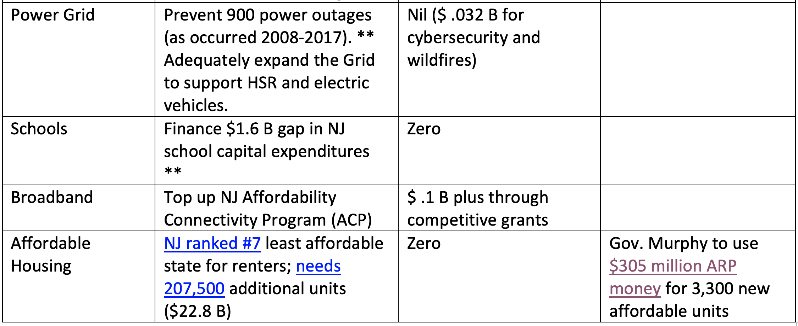
Whats in it for
New Jersey?
** Source: American Society of Civil Engineers Report Card for New Jersey

Slide 38
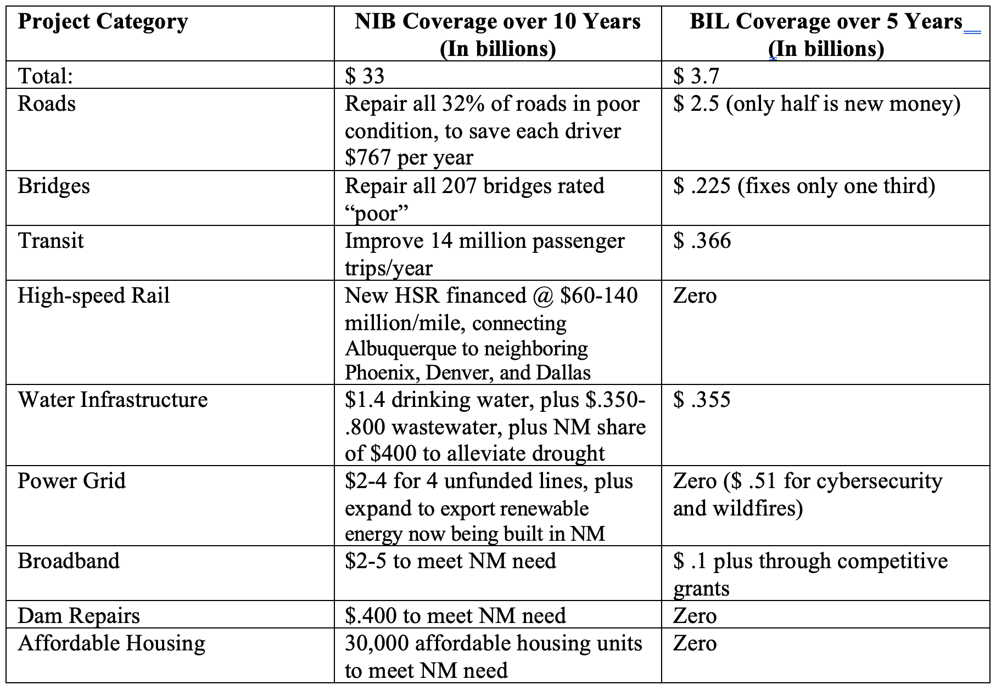
What’s in it for New Mexico?
Infrastructure and the Economy:
Roads, bridges, dams, & water infrastructure in poor condition. 20% of homes lack internet. Severe drought. Power grid needs expanding.
Sparce population; large land mass.
Second highest poverty rate (18.2%). 3rd highest Tribal population. Agriculture accounts for 52% of land use, and 7% of employment. Affected by water scarcity.
NM will receive the following from the NIB:
Up to $33 billion over 10 years, creating 160,000 new, family sustaining jobs. (Compared to $3.7 B from BIL)
Other Benefits from NIB:
Enhance education to train workers in new industries.
Improve state and city finances through economic growth.
NM will receive the following from the NIB:

Slide 39
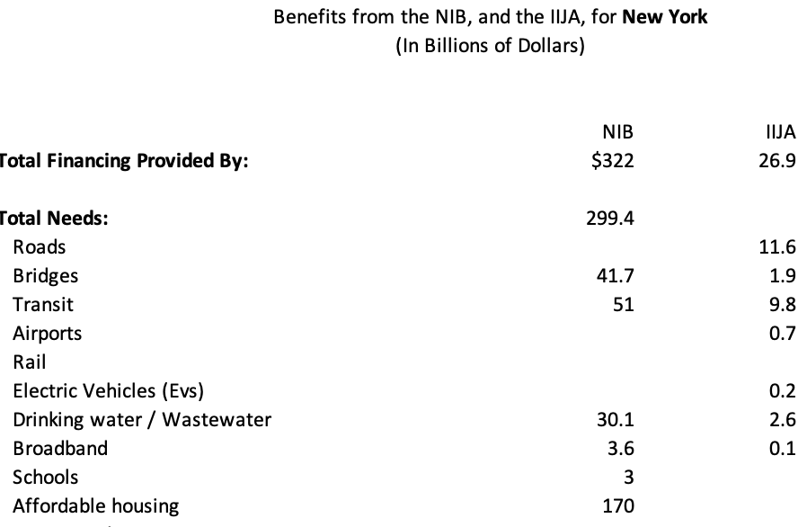
What’s in it for New York State?
NY State will receive the following from the NIB:
Up to $322 billion new money over 10 years. (Compared to $27 B only from the IIJA.)
Creates up to 1.6 million new, family sustaining wage jobs, Buy America provisions to promote American manufacturing.
FULL financing for big ticket projects like: Gateway Project, high speed rail along the Northeast Corridor, general increase passenger rail to combat congestion and save fuel , and placing the Metropolitan Transit Authority on sound financial footing.
Improve state and city finances through economic growth.
Cities and Rural Areas would get:
Three high speed rail lines: North East Corridor from DC to Boston, Empire NYC-Albany, and Lakeshore Buffalo-Cleveland.
Direct financing for: schools, to replace all city’s lead lines water service lines, fix: local roads, stormwater, and sewer systems, and roll out affordable broadband.
Enhance education to train workers in needed fields. Ex: LIUNA trade apprenticeship programs.
Promote inner-city community development. And build affordable housing to complement the NY Comprehensive Housing Plan and NY Housing Compact.

Slide 40
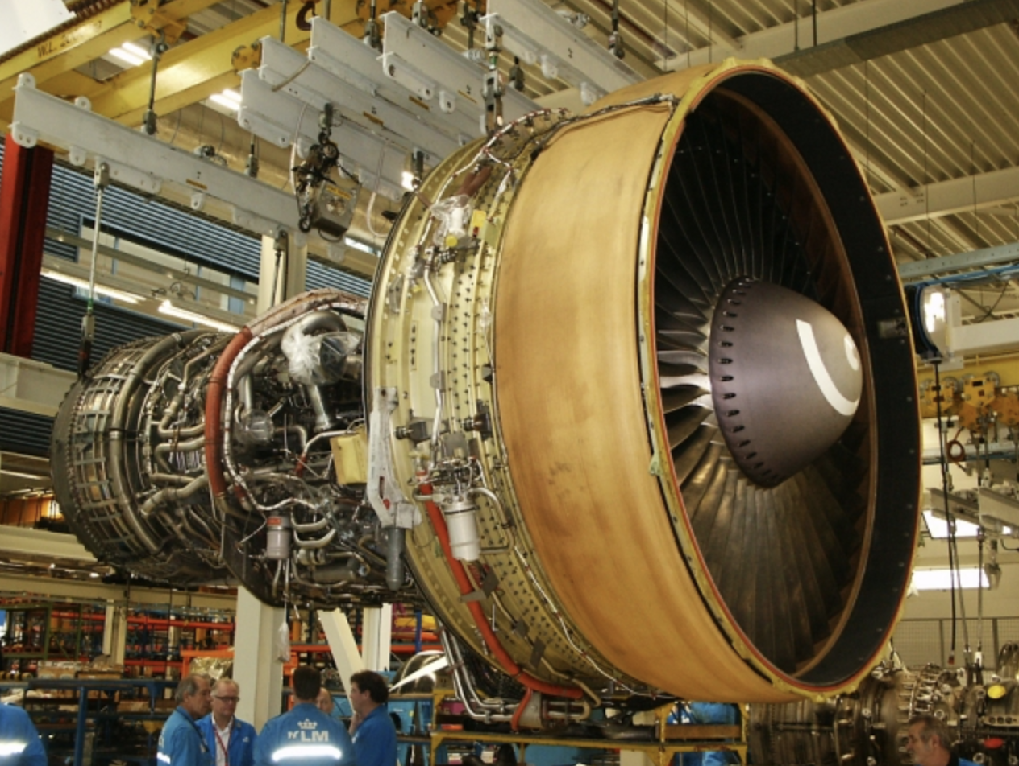
What’s in it for Ohio?
OH 2021 ASCE Infrastructure Report Card Grade: C-
Grades of D for: Roads, stormwater, drinking water and wastewater ($13 B needed) inland waterways and transit.
OH’s Economy
CNBC 2021 rated OH top 10th for doing business, but graded workforce and quality of life D-. Bond Rating: AA+
Manufacturing fallen from 53% of employment in 1942 to 13% in 2014. Walmart current top employer.
Today’s top industries: health care, aerospace & defense, agriculture, auto manufacturing, and iron and steel.
OH will receive the following from the NIB:
Up to $163 billion over 10 years to cover all of the states infrastructure financing gap. (Only $12.8 B from IIJA).
Create 813,000 new great paying jobs, with Training.
Repair/replace 3,246 bridges @$2.6 B, + Brent Spence corridor (needs $3.6 B ($2B from OH); gets $1.6B from IIJA).
Improve roads, ports and inland transportation. Build high speed rail and affordable housing. Restore rural drinking water.
Promote manufacturing through Buy America provision.
GE Aviation, headquartered in Evendale

Slide 41
What’s in it for Pennsylvania?
Pennsylvania will receive the following from the NIB:
Up to $220 billion over 10 years to cover all of the states infrastructure financing gap. (Only $17 B from IIJA.)
Creates over 1 million new great paying jobs in the state. Certified training. Earn while learning.
Revitalizes PA manufacturing thru Buy America Only.
NIB Reaches ALL Projects in Rural and Inner City Areas
Bridge Collapse! NIB replaces all 3,300 PA bridges in poor condition (needs $12.7 B; IIJA covers only $1.6 B).
Fixes: all roads (2nd worst in US; $8 B backlog); transit; and drinking, wastewater, and stormwater systems ($26.6B funding gap) (all graded D by ASCE in 2022).
Less well known: lead water service lines.
Builds High Speed Rail and Mass Transit solve traffic congestion.
Complete, Affordable Broadband everywhere.
NIB would not privatize public infrastructure (as happened in 8 PA townships, raising water rates 50-90%, and proposed for 9 toll bridges).
Community development with Bundled Projects.
Transportation Economics & Management Systems, Inc.

Slide 42
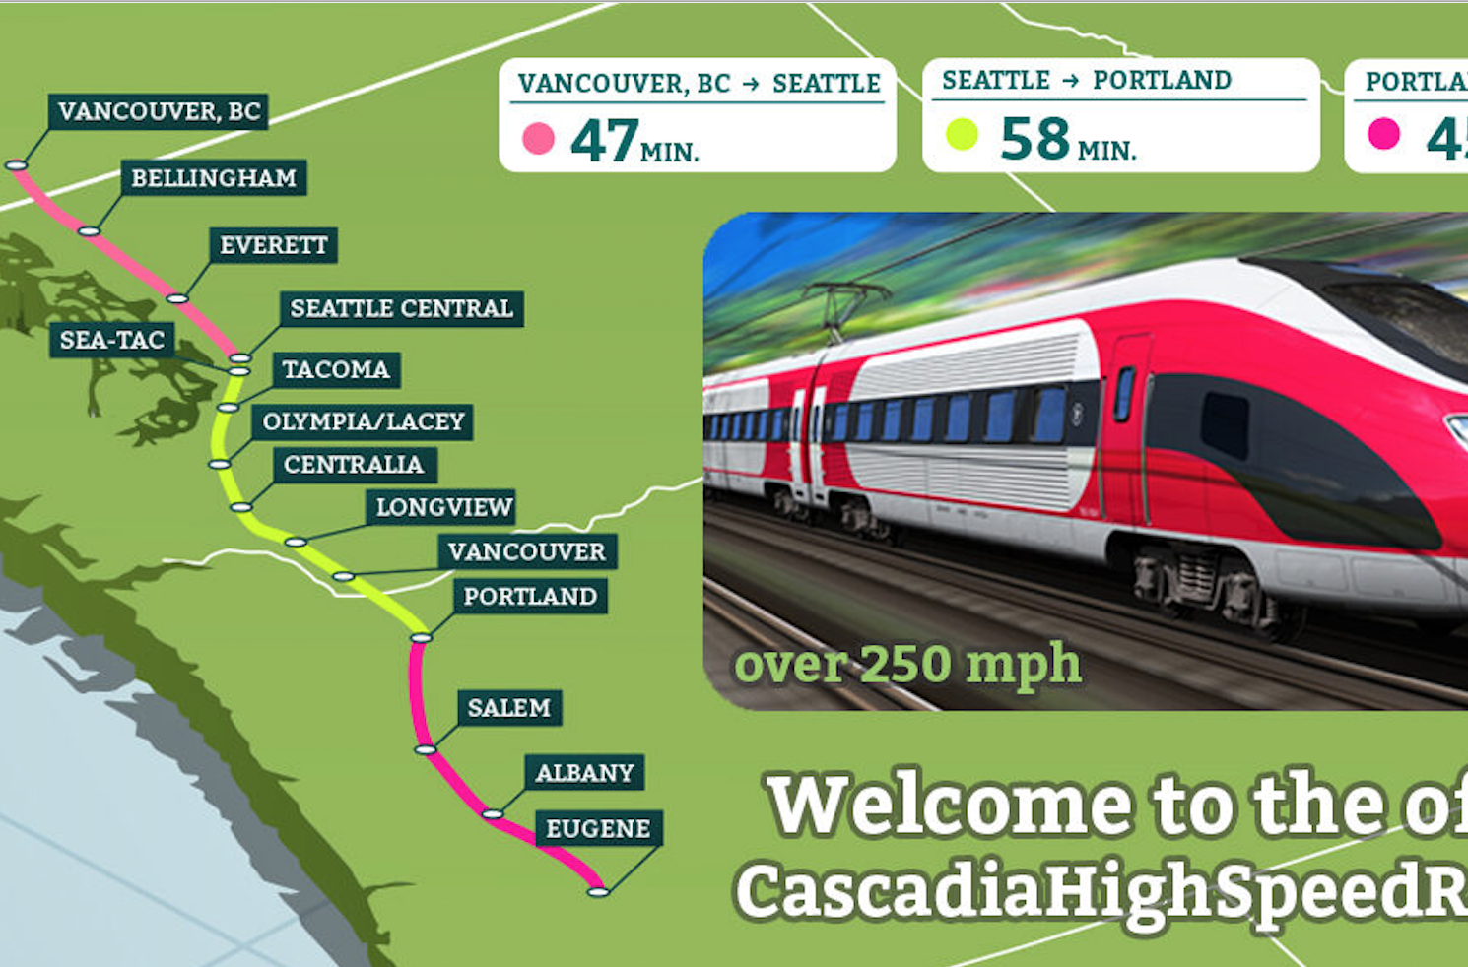
What’s in it for Oregon?
OR 2019 Infrastaructure Report Card Grade: C-
Grades of D for: Damns, levees, wastewater ($5 billion needed) and energy.
OR’s Economy
CNBC 2019 gave OR an A- for economy, but F for cost of living. Bond Rating: AA+
17th highest median household income ($60,000)
Industries: agriculture, forestry and fisheries, tourism and entertainment, technology.
OR State will receive the following from the NIB:
Up to $68 billion over 10 years to cover all of the states infrastructure financing gap. (Only $1.6 B from IIJA).
Creates 340,000 new great paying jobs, with Training.
Repair critical roads & bridges; improve ports and inland transportation. Build high speed rail.
Stimulate business through Buy America requirement.

Slide 43
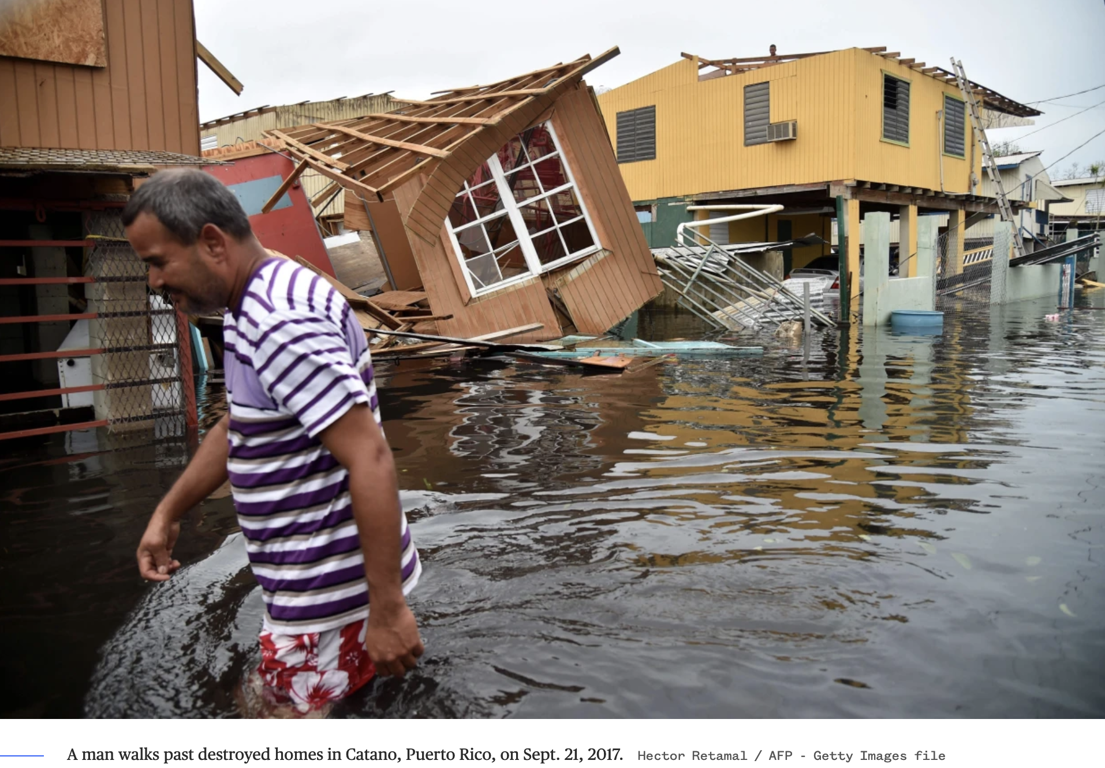
What’s in it for Puerto Rico?
Territory will receive the following from the NIB:
Up to $48 billion over 10 years, creating 240,000 new great paying jobs. (Compare: Only $2.3 B from IIJA, very little from FEMA.)
Direct financing to address: ASCE 2019 Report Card D-. Needs $13-23 billion over 10 years. Expensive electricity, power outages increased despite privatization. And still not resilient to Hurricanes Fiona and Ian. Poor roads and bridges (100% and 12%, respectively), schools closed, drinking and waste water systems ($3.3 B needed over 10 years), 36 high hazard dams, and affordable housing.
Provide training & great paying jobs for 41% of population living in poverty. Promote community development, including through NIB Trust Fund grants.
Improve state and county finances through higher economic growth. Offset finances to deal with bankruptcy proceedings.
Puerto Rico sees more pain and little progress three years after Hurricane Maria, Sept. 2020.

Slide 44
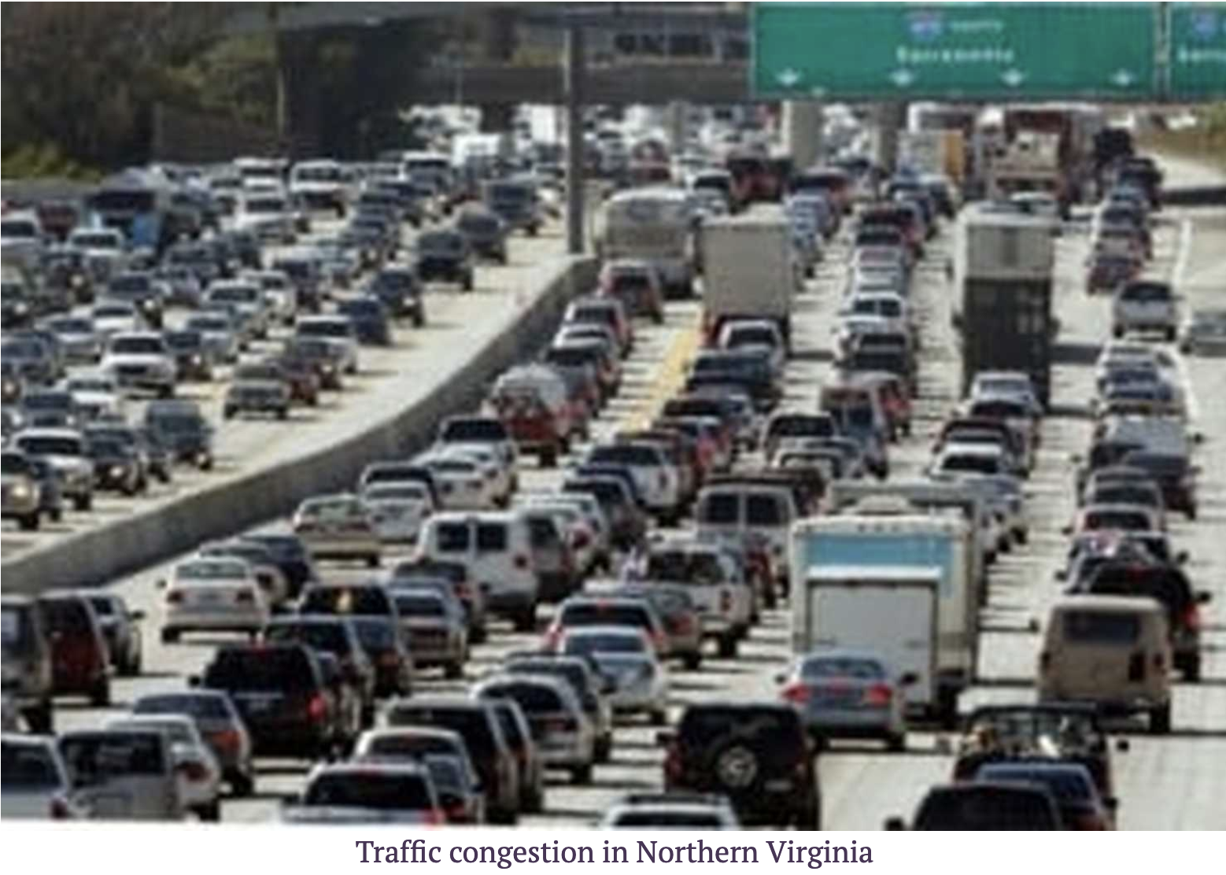
What’s in it for Virginia?
State will receive the following from the NIB:
Up to $113 billion over 10 years, creating 570,000 new great paying jobs. (Compare: Only $10 B from IIJA, of which, only $.4 B for rail, and $.1 B for broadband)
Full financing for big ticket items like: high speed rail and mass transit to fundamentally reduce traffic congestion (DC is 5th worst city).
Direct financing for, complete broadband, schools, roads and bridges, stormwater, drinking water and sewer systems, ports, and affordable housing.
Bundle projects. Promote rural development.
Enhance education to train workers in needed fields. Ex: “Earn and Learn” trade programs.
Improve state and county finances through higher economic growth.

Slide 45
What’s in it for Washington State?
WA State will receive the following from the NIB:
Up to $91 billion over 10 years to cover all of the states infrastructure financing gap. (IIJA only $8.6 B new money)
Spending would create up to 460,000 new, family sustaining jobs, with Buy America provisions to promote American manufacturing.
Full financing for big ticket projects like: Portland-Seattle high speed rail, Seattle transit lines, full replacement of Seattle’s aging bridges ($ 6.3 billion; IIJA only $.6 B) --Seattle Grapples with How to Fund Massive Bridge Maintenance Backlog
Direct financing for: schools, potholed roads (worst nationwide), stormwater, drinking water and sewer systems, ports, affordable broadband, and affordable housing. Solve state’s homelessness.
Promote inner-city community development. Transport workers from home to work efficiently.
Enhance education to train workers in needed fields. Ex: LIUNA trade apprenticeship programs.
Improve state and city finances. Grow Businesses. Complement proposed state public bank.

Slide 46
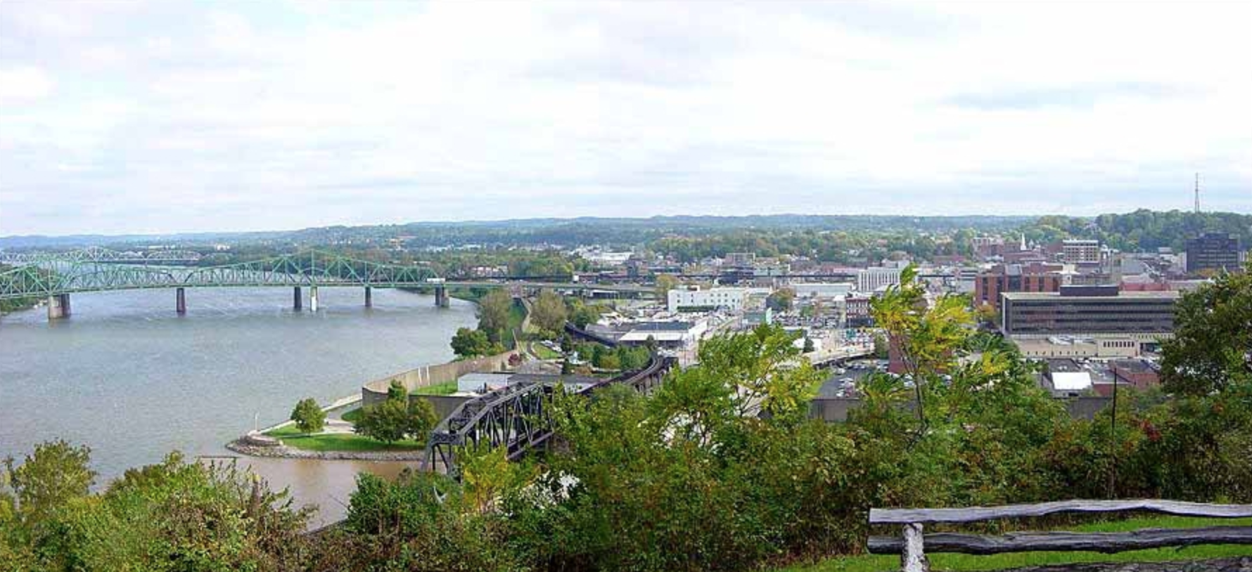
What’s in it for West Virginia?
WV 2020 Report Card Grade: D
Grades of D for: Roads (34% poor condition), Bridges (country’s highest: 21% structurally deficient), Damns, Drinking Water (needs $1.4 billion), and wastewater (needs $3.3 billion).
CNBC 2019 gave WV an F for Technological Innovation.
WV’s Economy
Industries: logging, coal mining, and significant outdoor recreational tourism. Diverse mix of more agile steel; plastic plants; healthcare; and insurance.
Third poorest state in the US, per capita income of $23,450 (2015). Major opoid crisis.
Bond Rating: AA-
WV State will receive the following from the NIB:
Up to $34 billion over 10 years to cover all of the states infrastructure financing gap.
Creates 170,000 new great paying jobs, with Training.
Repair critical roads & bridges; improve road safety. Blanket the state with high speed communications.
Stimulate WV Steel through Buy America requirement.
Parkersburg, West Virginia

